Slide 1
Slow manifold of the intermittent oscillatory reaction
Ž. Čupić
University of Belgrade, Institute of Chemistry, Technology and Metallurgy, Serbia

Slide 2
Belgrade Group
Belgrade group exists from 1984. and works in unsteady size and composition. The Group is mainly represented by:
Ljiljana Kolar-Anić and Slobodan Anić
Željko Čupić, Vladana Vukojević, Dragomir Stanisavljev, Nataša Pejić, Slavica Blagojević,
Smiljana Jelić, Jelena Maksimović, Ana Ivanović, Maja Milenković, Nebojša Potkonjak, Vladimir Marković, Stevan Maćešić, Stevan Blagojević, Branislav Stanković, Ana Stanojević, Aleksandra Stojiljković, Luka Negrojević, Aleksandar Lončar

Slide 3
Intermittent oscillations are one of the most intriguing non-linear phenomena in reaction systems. They occur when two attractors coexist in the phase space of the dynamical system and cause apparently unpredictable behavior with sudden jumps between bursts of large amplitude oscillations and potentially long quiescent periods. Our model of oscillatory reaction explains the role of the slow manifold governing intermittent oscillations.

Slide 4
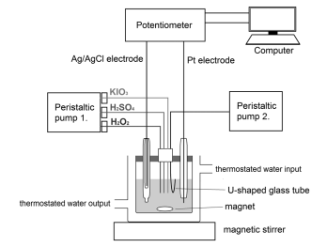
Figure 1. Continuous Stirred Tank Reactor (CSTR). If pumps are removed, the batch reactor is obtained.

Slide 5
Reaction
mechanism
Schmitz, G,
J. Chim. Phys.
84 (1987) 957-965.
Kolar-Anić, Lj,
Schmitz, G,
J.Chem.Soc.Faraday Trans.
88 (1992) 2343-2349.
Kolar-Anić, et al,
React. Kinet. Catal. Lett.
54 (1995) 35-41.
Lj. Kolar-Anić, et al,
J.Chem.Soc.Faraday Trans.,
93, (1997),2147-2152.
Ž. Čupić,
Lj. Kolar-Anić,
J. Chem. Phys.,
110, (1999), 3951-3954.

Slide 6
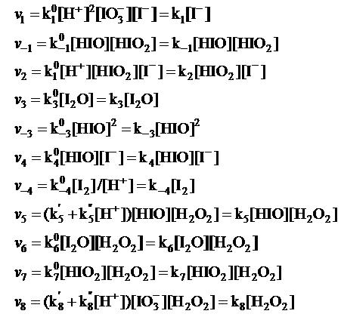
Reaction rates

Slide 7
Reaction dynamics in batch reactor

Slide 8
Nullclines of BL in batch reactor
FAST
FAST
FAST
FAST
SLOW

Slide 12
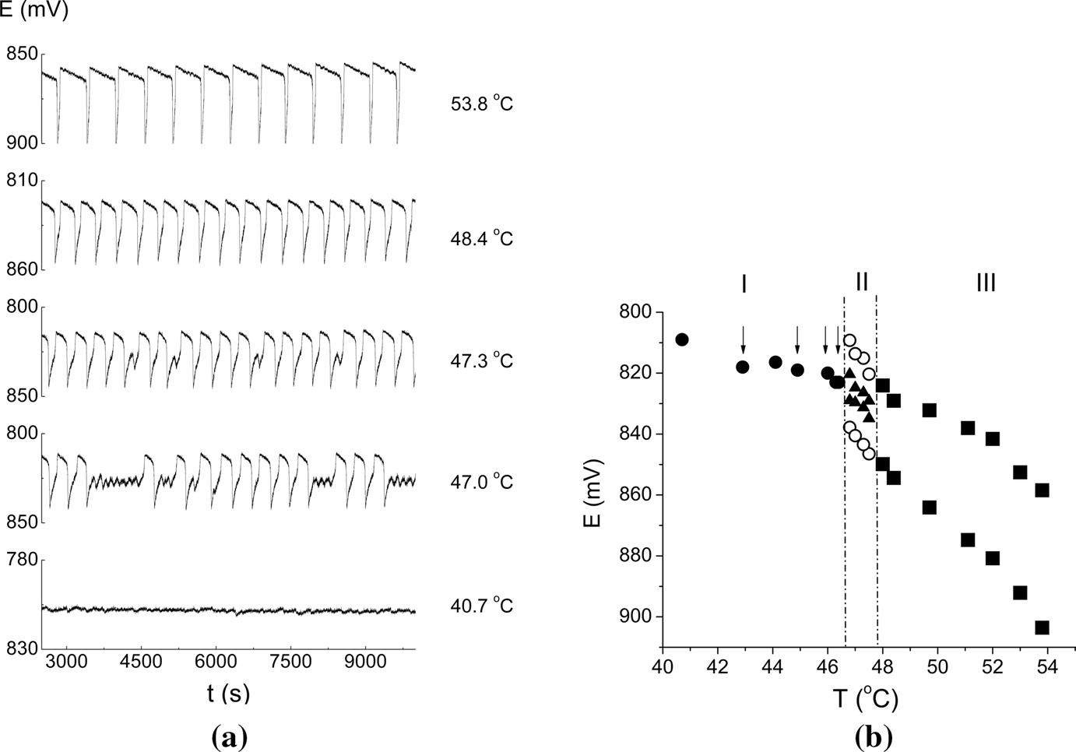

Slide 13
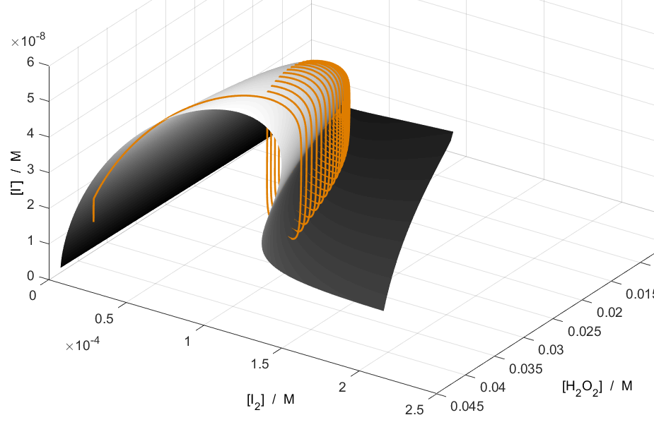
Figure 6. Surface of slow nullclines for a sequence of [H₂O₂] values and trajectory of the BL reaction obtained for the Model(1-8) in the batch reactor.

Slide 14
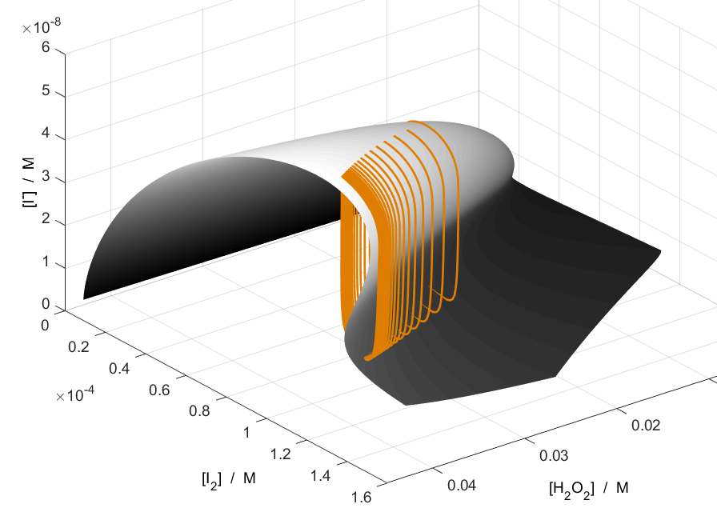
Figure 7. Surface of slow manifold and trajectory of the BL reaction obtained for the Model(1-15) in the CSTR.

Slide 15
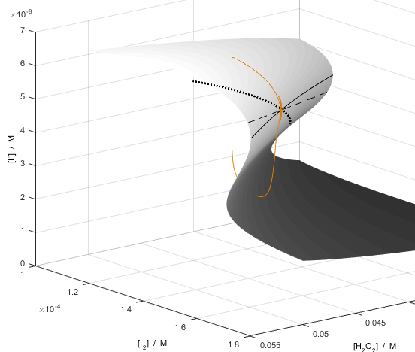
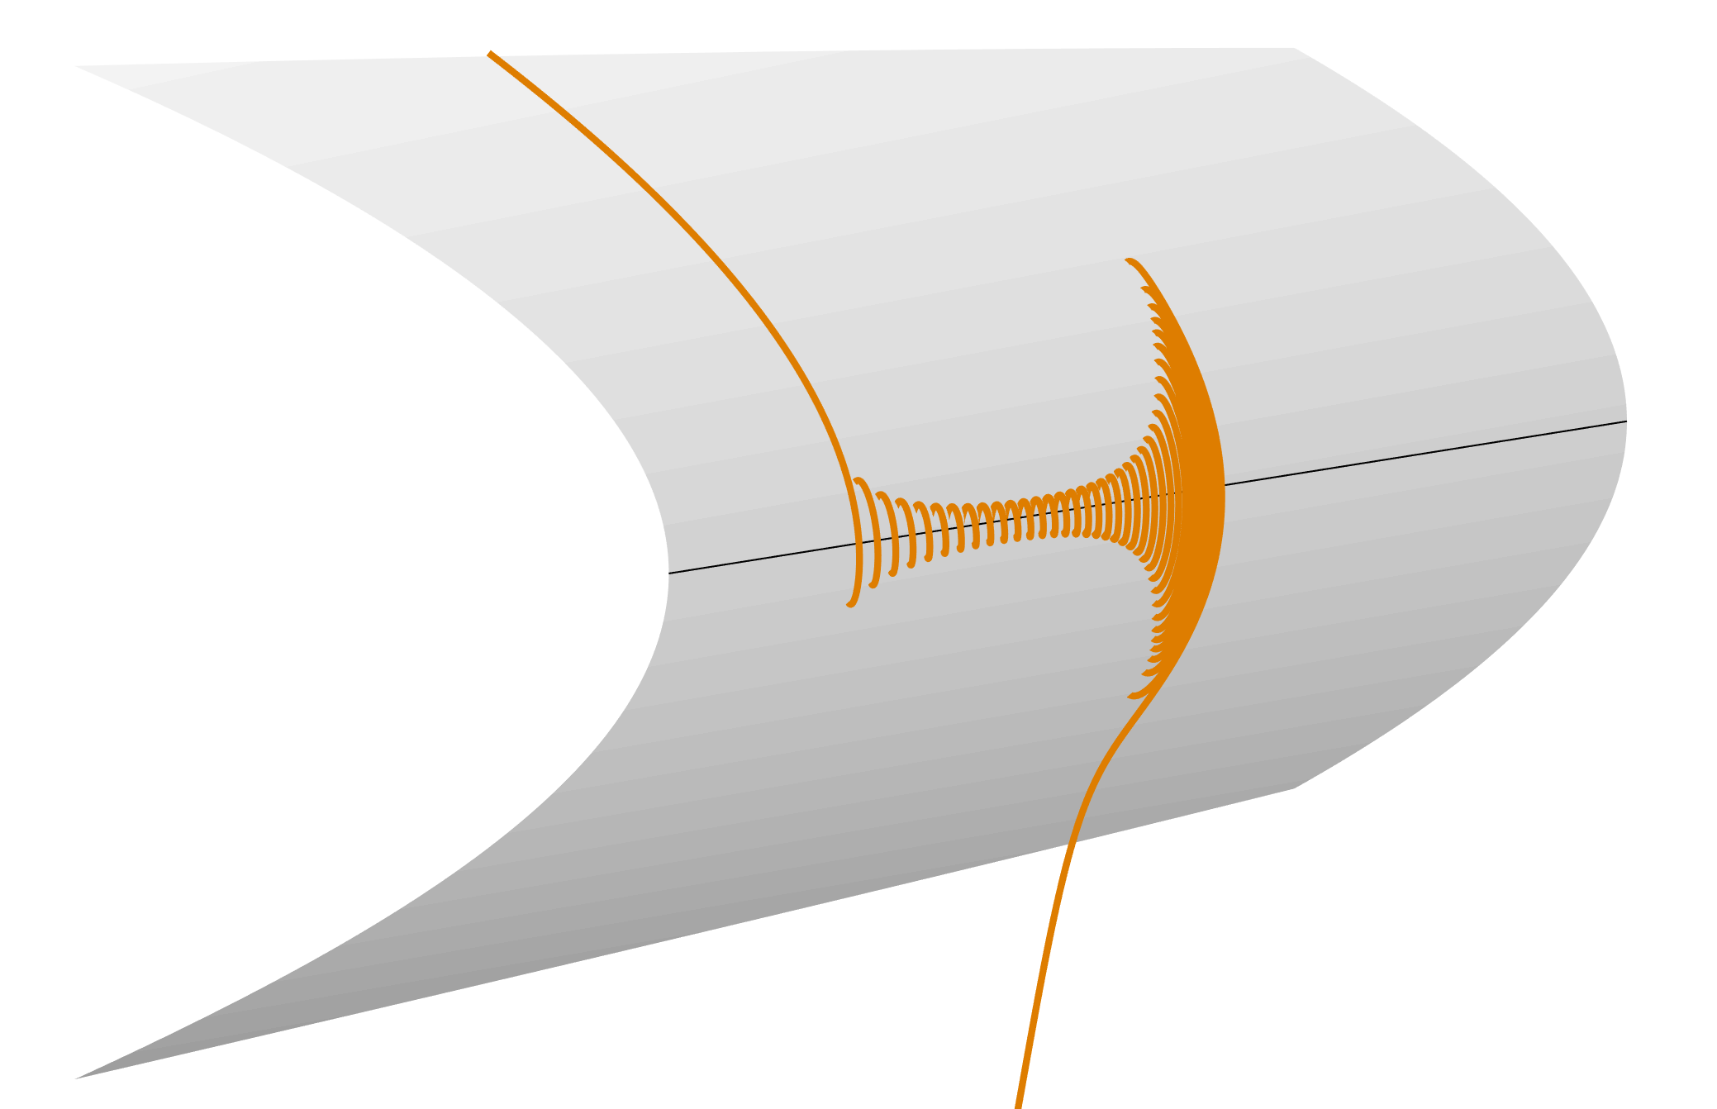

Slide 16
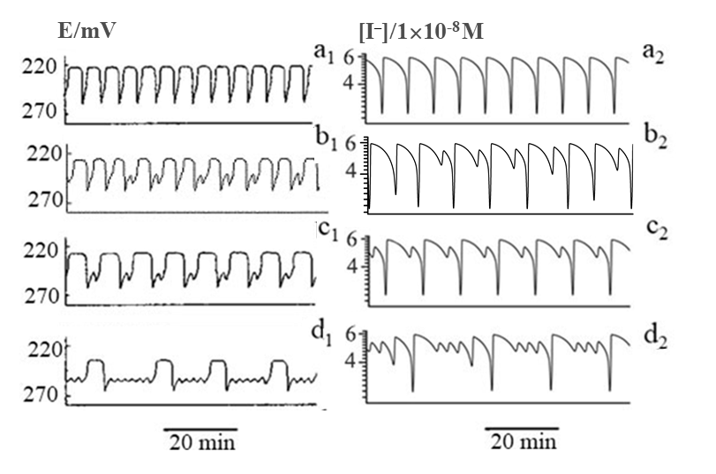
Figure 1. Different dynamical states obtained in the BL reaction experimentally (a₁-d₁) and numerically (a₂-d₂).
control parameter was specific flow rate: (a2) j0=3.023×10ˉ2 minˉ1, (b2) j0=3.041282561×10ˉ2 minˉ1 (c2) j0=3.0507014028×10ˉ2 minˉ1, (d2) j0=3.0687374749×10ˉ2 minˉ1.

Slide 17
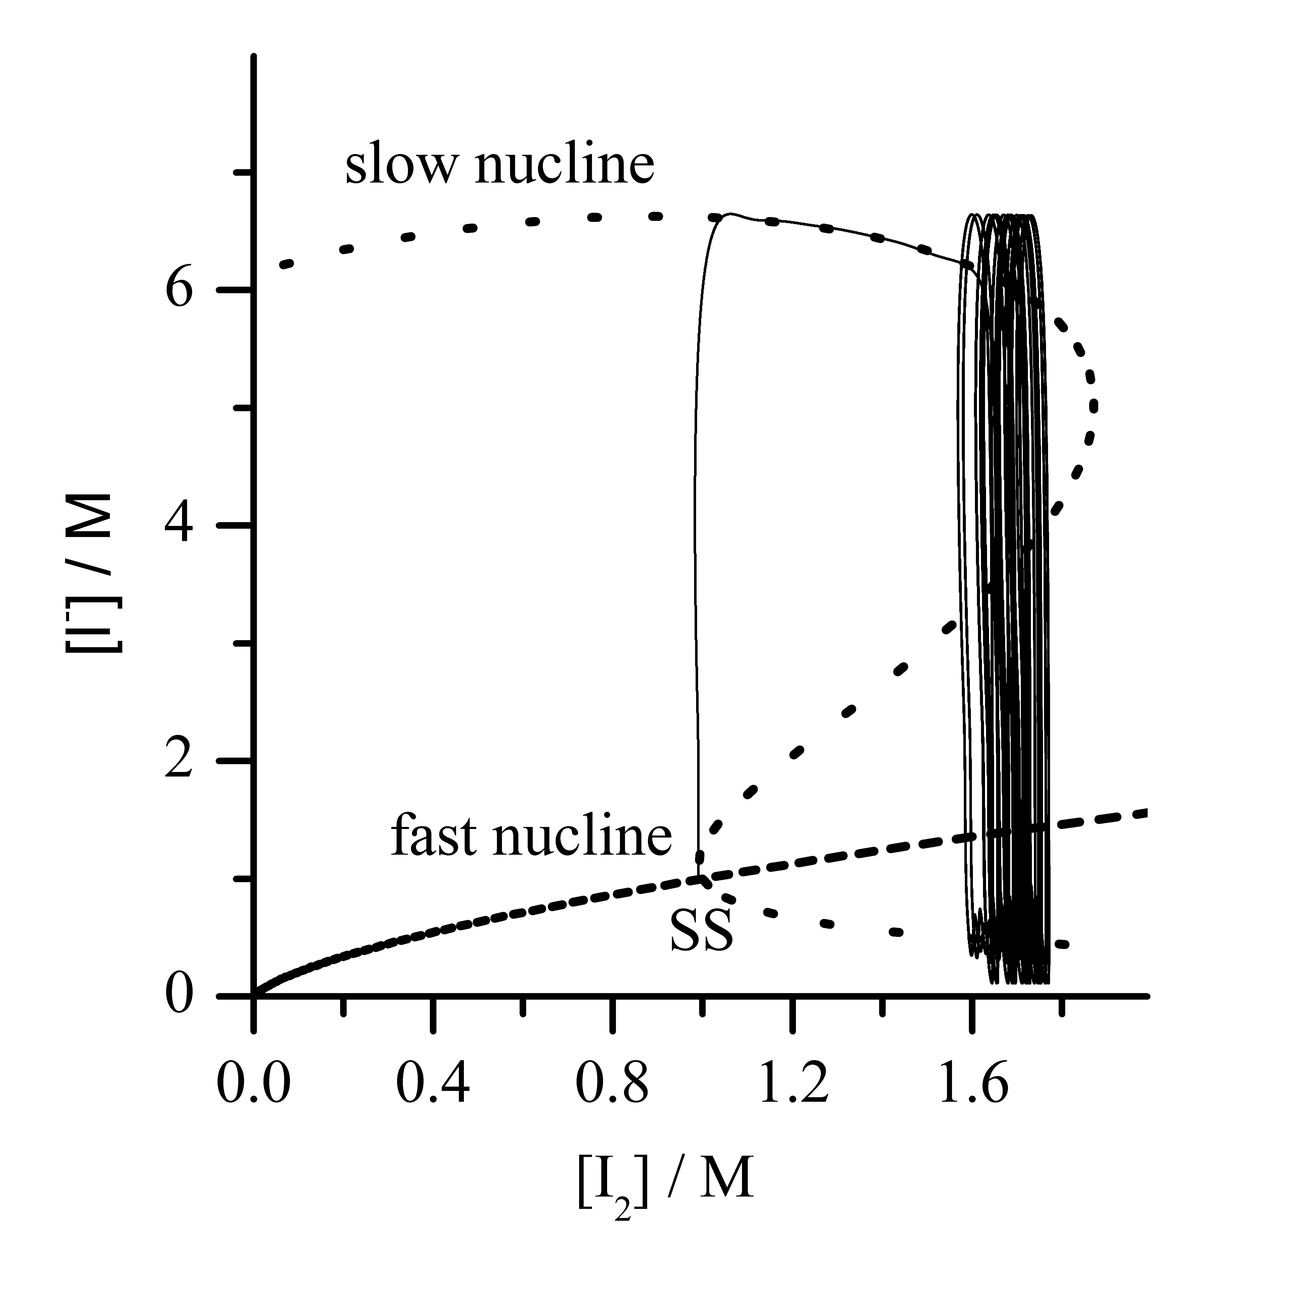

Slide 19
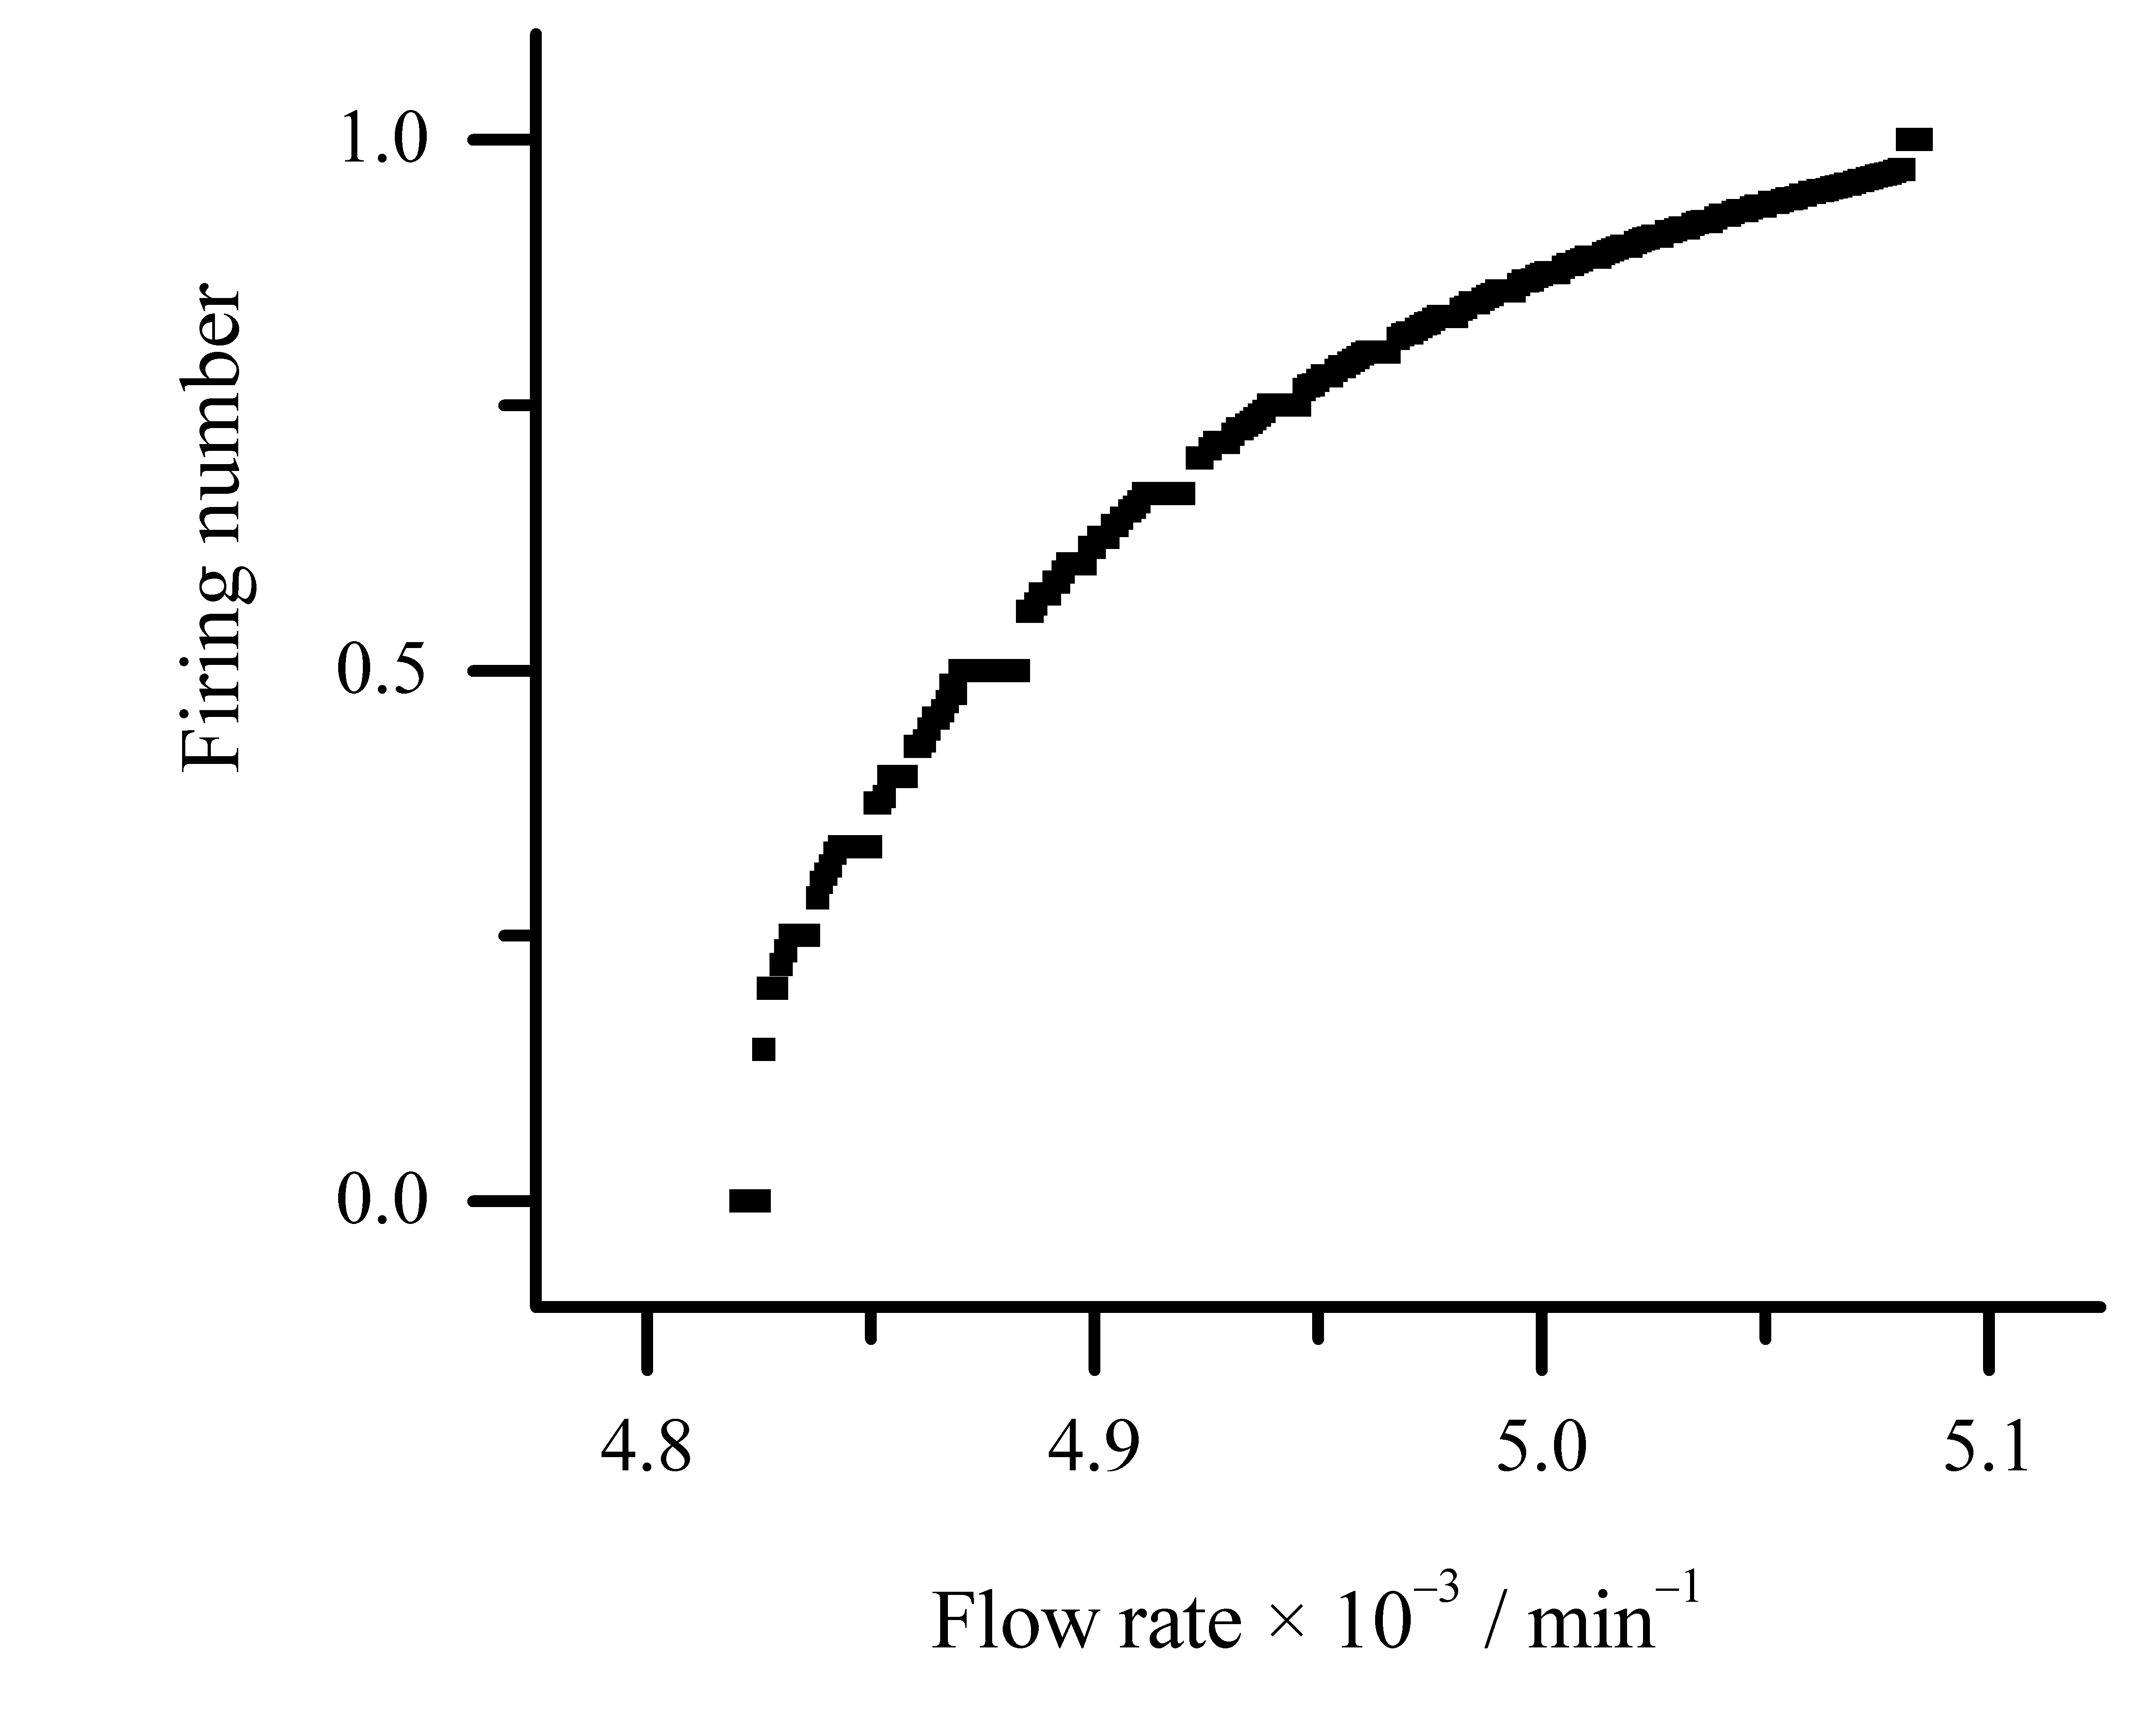
Figure 9. Devil's staircase. Firring number as a function of flow rate for the Model(1-15).

Slide 21
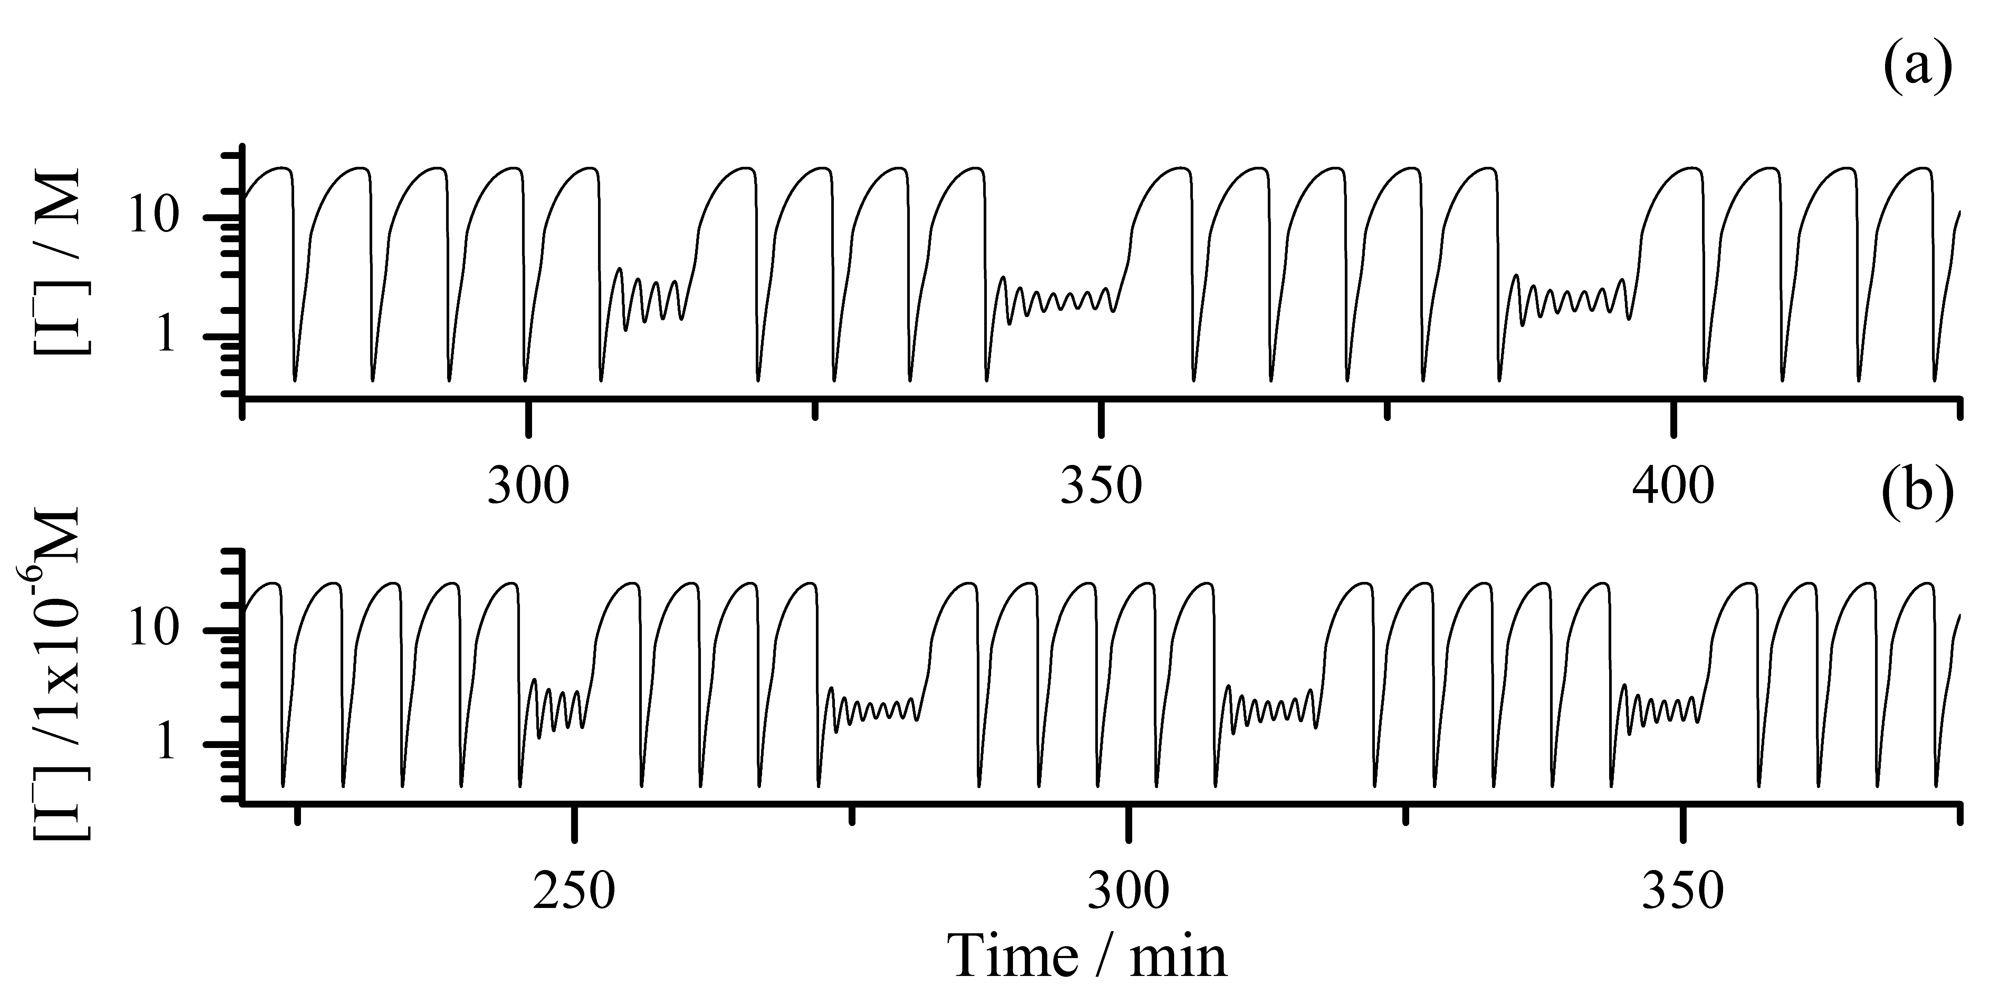

Slide 22
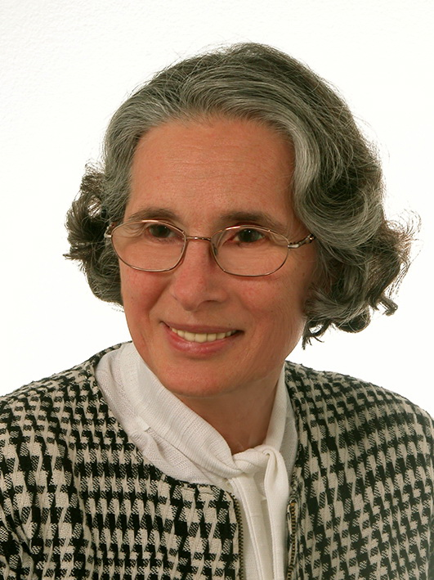


This research was supported by Science Fund of Republic of Serbia #Grant Number. 7743504, Physicochemical aspects of rhythmicity in neuroendocrine systems: Dynamic and kinetic investigations of underlying reaction networks and their main compounds, NES.
Special thanks to:
Prof. Dr Ljiljana Kolar-Anić (1947-2023)
Thank you for your attention!

