Slide 1
Davydov model of charge and energy transfer in molecular crystals Zoran Ivić^{1,2}, Violeta Nikolić, Dalibor Chevizovich and Željko Pržulj¹ ¹Vinča Institute of Nuclear Sciences, National Institute of the Republic of Serbia University of Belgrade, Belgrade, Serbia ²Institute of Theoretical and Computational physics, Department of Physics, The University of Crete, Heraklion, Greece
3rd CONFERENCE ON NONLINEARITY 4—8.09.2023, Belgrade, Serbia

Slide 2
Crisis in Bioenergetics
Davydov model: Resolution of crisis in bioenergetics
Crisis in bioenergetics
Counterintuitive extremely high efficiency of long-distance energy transfer
Energy production-hydrolysis
Of ATP
Exploitation
Efficiency 98%
HOW – Which mechanisms provide so high efficiency

Slide 3
Possible answers
Synergetic: released to biological environment
Acts as heat bath supporting biochemical reactions
Donor-acceptor model through “BRIDGES” biological macromolecules,
α-helical proteins and DNA as mediator

Slide 4
Molecular bridges
Band mechanism: Consideration of the problem through the prism of Quantum theory of solids
Simplified model 1d molecular crystal
Translational invariance of biological macromolecules – periodic arrangement of peptide groups mediator helix
Dipole-dipole coupling between neighboring provides energy transfer
Δ Energy released in ATP hydrolysis
J
Inter PG dipole-dipole coupling
Resonant transfer of Δ from “Donor” to PG group
and its “collectivization” - “exciton”

Slide 5
Exciton vs soliton model
Exciton are unstable and quickly spread and decay
Davydov: proposal of soliton model
Stabilization of quasiparticle state through the interaction with lattice modes: trapping by local deformation
Small polaron
Binding energy
Davydov soliton-bound state of local deformation of lattice and “excitation”
Phonon-assisted quasiparticle stabilization
The main obstacle turned into an advantage

Slide 6
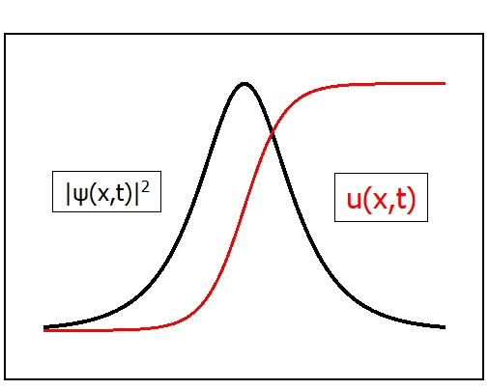
Stabilization
Physical: energy lowering and formation of BS
Formal: IST arguments
Topological: kink-like form of lattice deformation
$H=∆\sum_{n}{B_{n}^{+}}B_{n}−J\sum_{n}{{(B}_{n}^{+}}B_{n+1}$+h.c) + $χ\sum_{n}{B_{n}^{+}}B_{n}$(u_{n+1}-u_{n-1}) + H_{latt}
|$Ψ> =|ψ>⨂| φ$ $>$, semiclassical analysis results in NLSE
$iℏ\dot{Ψ}{=−\frac{ℏ 2}{2JR2}Ψ}^{′′}−G|Ψ|2$ $Ψ$
$ψ=\sqrt{\frac{μ}{2}}\cosh^{−1}{\frac{μ}{Ro}}$(x-x₀-vt), $u\sim \sqrt{\frac{μ}{2}}\tanh{\frac{μ}{Ro}}$(x-x₀-vt)
IST arguments: Infinite number of integrals of motion
No mixing different branches of NLSE spectrum-soliton and continuum
Topological: kink-like soliton – lattice deformation are topologically stable

Slide 7
Controversies
Pointless Criticism: The consistency of the method (DA) with quantum mechanics
Are DS-solutions true solutions of the Schrödinger equation for DM
Of course, they are not but when some approximative solutions may pretend to exactness
Less pointless: when DST offers a physically reliable picture of some physical phenomenon
Resolution
Discussion on the validity of DST within system parameter space

Slide 8
ST basics
quasi-particles in the CM form various types ST states polaron - small, large, magnetic, acoustic, …
Each of which appears for particular values of system parameters
Quasi-particle bandwidth, characteristic phonon frequency:
2J, ω₀ and $E_{b}=\frac{4χ^{2}}{Mω_{0}^{2}} −SP binding energy$
Their mutual ratio determines
The type of ST state and
The choice of the mathematical tool
Approximation
Two well-known limits
Adiabatic 2J>> ћω₀
large polaron and semiclassical approximation

Slide 9
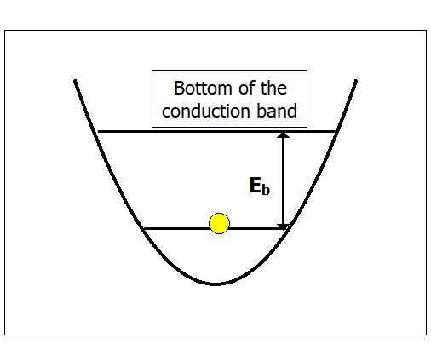
DST vs ST
DS-must be adiabatic ST state $<=$semiclassical analysis
Also strong coupling E_{b} >>ћω₀
so that phonons can not excite QP from the well
Large radius
Basic parameters and their ratios
B=2J/ћω₀ –adiabatic ratio
S=Eb/ћω₀ –coupling constant
l $\sim$B/S – dimensionless length
Conditions of existence and validity
of the physical picture
B>>1
S>>1
B>>S

Slide 10
Thermal stability
What Davydov oversaw? NLSE was derived by taking only particular solutions for lattice modes. Accounting for fluctuation homogeneous part yields perturbed - STOCHASTIC NLSE
$iℏ\dot{Ψ}{=−\frac{ℏ 2}{2JR2}Ψ}^{′′}−G|Ψ|2$ $Ψ+f(x,t)$ $Ψ$
$$\left\langle f\left(x,t\right)f(x^{′},t′)\right\rangle =E_{B}kT\sum_{j=±1}{δ(x−x^{′}+jc(t−t^{′}))}$$
Which is not integrable implying soliton instability
Within the IST perturbation theory DS lifetime is estimated as
$τ \sim$2.2 $×{10}^{−2 }\frac{S}{sB}\frac{ℏω}{kT}$

Slide 11
Conclusions
α-helix DNA & conducting polymers
B $\sim 0.1$ B $\sim$100
S $\sim 0.17$ S $>>$ 1
DS-large polaron may be relevant for transfer processes in DNA and conducting polymers
In α-helix small-any-adiabatic polaron

