Slide 1
3rd Conference on Nonlinearity (Sept. 2023, Belgrade)
Stanko N. Nikolić, Sarah Alwashahi,
Najdan B. Aleksić, Milivoj R. Belić
Various rogue wave clusters of the
nonlinear Schrödinger equation
Division of Arts and Sciences, Texas A&M University at Qatar
Institute of Physics Belgrade, University of Belgrade, Serbia
stanko.nikolic@qatar.tamu.edu

Slide 2
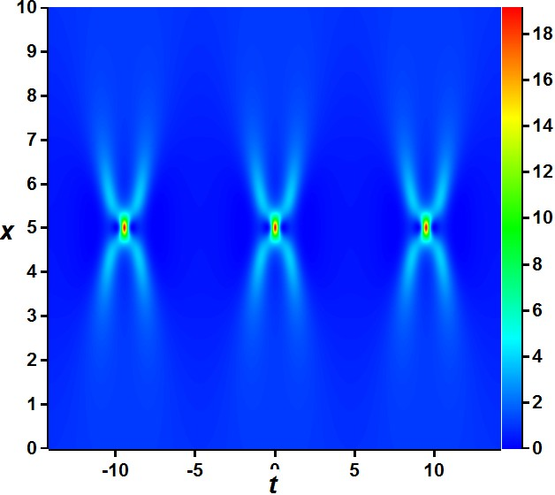
3rd Conference on Nonlinearity (Sept. 2023, Belgrade)
Outline of the talk
I Nonlinear Schrödinger equation (NLSE) and Darboux transformation
II Rogue waves clusters composed of the Akhmediev breathers
III Rogue waves clusters composed of the Kuznetsov-Ma solitons

Slide 3
3rd Conference on Nonlinearity (Sept. 2023, Belgrade)
I Nonlinear Schrödinger equation (NLSE)
Ψ= Ψ(x,t) wave function,
x – evolution variable, t – “spatial” variable
Why NLSE? It is one of the most studied partial differential equations in nonlinear sciences since 1960s.
Applications: nonlinear optics, Bose-Einstein condensates, oceanography, plasmas…

Slide 4
3rd Conference on Nonlinearity (Sept. 2023, Belgrade)
I NLSE solutions from plane wave seed:
Analytical solutions can derived from seed solutions using
Darboux transformation technique (DT).
Akhmediev breathers (AB)
Kuznetsov-Ma soliton (KMS)
Any n^{th}-order DT solution requires n complex eigenvalues and n evolution and transverse shifts:

Slide 5
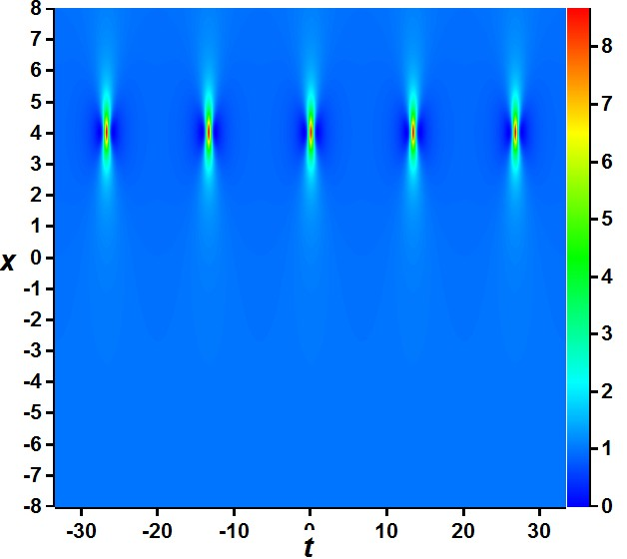
3rd Conference on Nonlinearity (Sept. 2023, Belgrade)
Eigenvalue υ
determines :
Solution type (AB or KM),
Period T
Evolution shift x_{SH}
determines:
Translation along x-axis
The DT order n
determines:
Intensity pattern
First-order AB and KMS are building blocks in DT for higher-order solutions and RW!

Slide 6
3rd Conference on Nonlinearity (Sept. 2023, Belgrade)
I Darboux transformation (DT):
1. For each eigenvalue λ_{j} (1 ≤ j ≤ n) we define:
3. Recursive relations are used
to compute r_{n,1} and s_{n,1}:
2. We next calculate Lax pair functions r and s:
4. Wavefunction of n^{th} order:

Slide 7
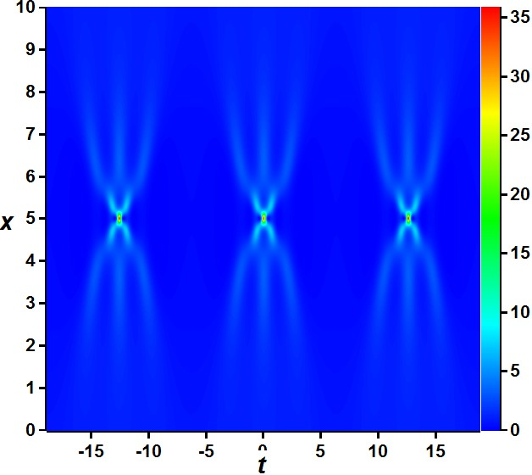
3rd Conference on Nonlinearity (Sept. 2023, Belgrade)
IIa Simple array of rogue waves (RW) composed of ABs
Rogue waves are narrow and strong intensity peaks with |ψ|² > 9
1. Commensurate
frequencies:
2. Evolution shifts are zero!

Slide 8
3rd Conference on Nonlinearity (Sept. 2023, Belgrade)
IIb Multi-elliptic rogue wave clusters composed of
the Akhmediev breathers
n – overall DT
order
m – number of
nonzero shifts
1. Commensurate frequencies:
2. Evolution shifts:

Slide 9
3rd Conference on Nonlinearity (Sept. 2023, Belgrade)
IIb Multi-elliptic rogue wave clusters composed of
the Akhmediev breathers
AB of order n-2m is formed at center (RW_{n-2m})
m ellipses around the central RW
Outer ellipse contains 2n-1 AB1, each following 4 less

Slide 10
3rd Conference on Nonlinearity (Sept. 2023, Belgrade)
IIc Multi-elliptic rogue wave clusters composed of
the Akhmediev breathers on dn background
RW cluster is built on Jacobi elliptic dnoidal background
Seed function in DT scheme:

Slide 11
3rd Conference on Nonlinearity (Sept. 2023, Belgrade)
IIIa Simple periodic RW clusters of Kuznetsov-Ma solitons
Higher-order KMS built with
commensurate frequencies:
All n evolution shifts are zero
x - periodic arrays of RWs!

Slide 12
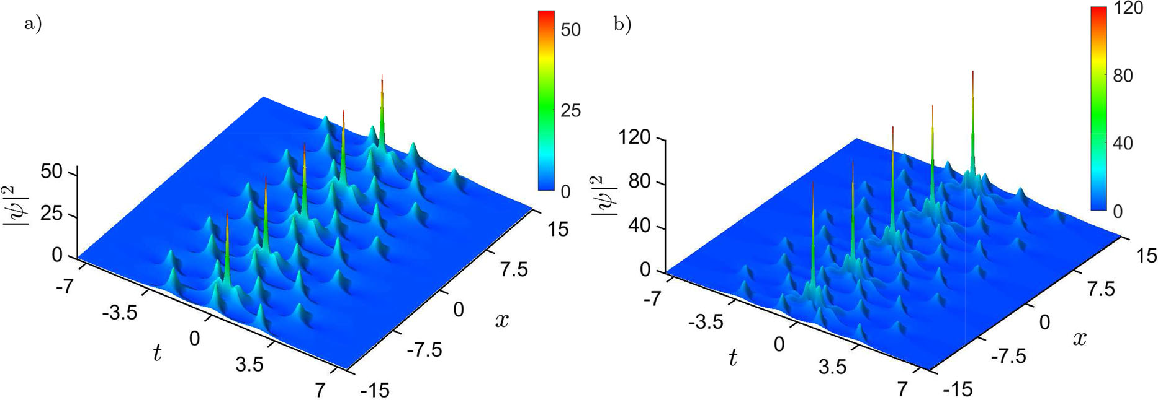
3rd Conference on Nonlinearity (Sept. 2023, Belgrade)
IIIb Kuznetsov–Ma multi-elliptic rogue wave clusters (KM MERWC)
Higher-order KMS built with commensurate frequencies
m nonzero and equal evol.shifts
KM of order n-2m at center, m ellipses around the peak
Outer ellipse contains 2n-1 KMS1, each following 4 less

Slide 13
3rd Conference on Nonlinearity (Sept. 2023, Belgrade)
IIIb Kuznetsov–Ma multi-elliptic rogue wave clusters
(KM MERWC)

Slide 14
3rd Conference on Nonlinearity (Sept. 2023, Belgrade)
IIIc Long tail Kuznetsov–Ma RW clusters
Higher-order KMS with non-commensurate frequencies
Pure imaginary DT eigenvalues:
m nonzero and equal evol.shifts:

Slide 15
3rd Conference on Nonlinearity (Sept. 2023, Belgrade)
IIIc Long tail Kuznetsov–Ma RW clusters
RW of order n-2m
at (0,0) origin
n tails with KMS1
above and below
the central RW
Just for even n:
m closed loops
with KMS1 above
the central RW,
m-1 closed loops
with KMS1 below
the central RW

Slide 16
3rd Conference on Nonlinearity (Sept. 2023, Belgrade)
Conclusion
1. Darboux transformation is a straightforward algorithm that
offers incredible richness of exact NLSE solutions’
patterns
2. Simple RW array composed of ABs or KM solitons is
obtained under conditions of commensurate frequencies
and zero shifts
3. Multi-elliptic RW clusters of ABs or Kuznetsov-Ma solitons:
commensurate frequencies and nonzero shifts
4. Long tail KM clusters: specific frequency condition and
nonzero shifts. Solutions’ patterns depend on n and m

Slide 17
3rd Conference on Nonlinearity (Sept. 2023, Belgrade)
Thank you for your attention!
References:
1. Sarah Alwashahi, Najdan B. Aleksić, Milivoj R. Belić, Stanko N. Nikolić:
"Kuznetsov–Ma rogue wave clusters of the nonlinear Schrödinger equation"
Nonlinear Dynamics 111, 12495 (2023)
2. Stanko N. Nikolić, Sarah Alwashahi, Omar A. Ashour, Siu A. Chin, Najdan B. Aleksić, Milivoj R. Belić:
"Multi-elliptic rogue wave clusters of the nonlinear Schrödinger equation on different backgrounds"
Nonlinear Dynamics 108, 479 (2022)

