Slide 1
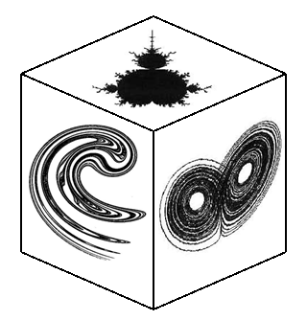


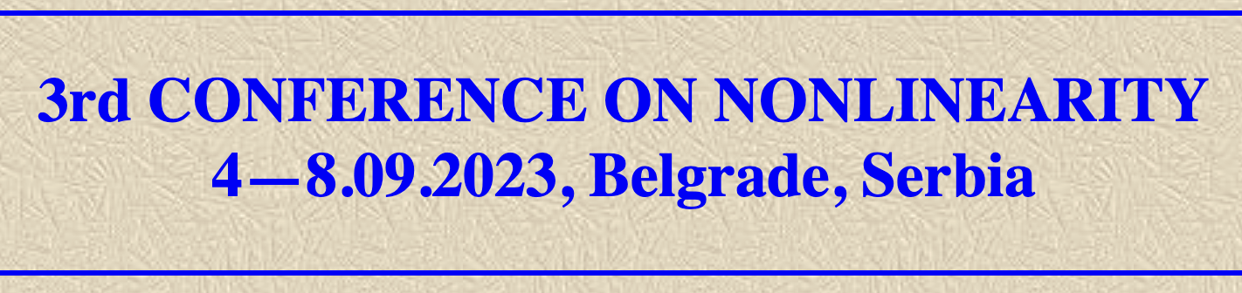
*
Móstoles, Madrid, Spain
Partial Control and Beyond: Controlling Chaotic Transients with the Safety Function
Miguel A. F. Sanjuán
Nonlinear Dynamics, Chaos and Complex Systems Group
Dept. of Physics, Universidad Rey Juan Carlos, Madrid, Spain

Slide 2
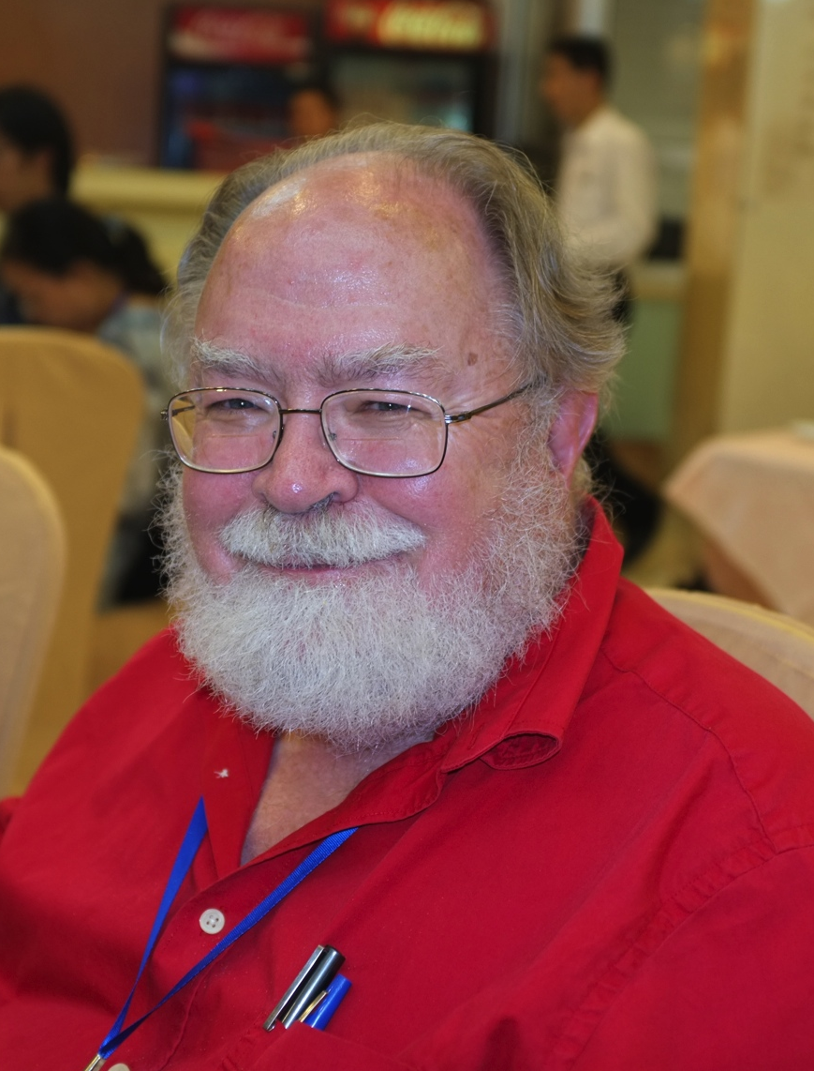
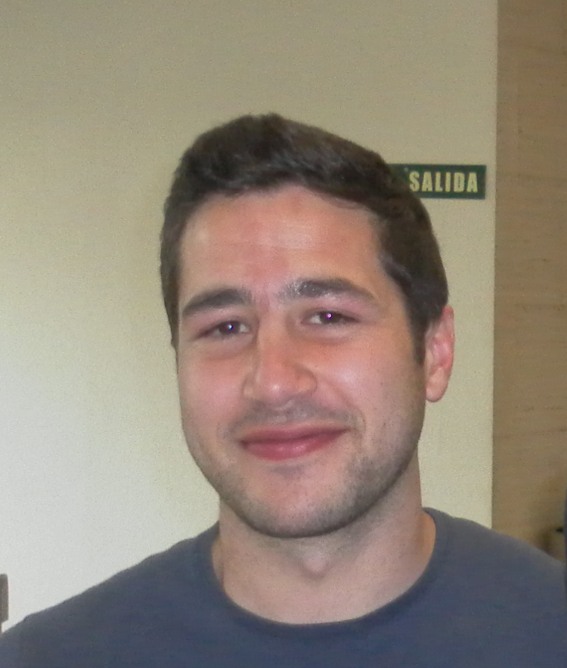

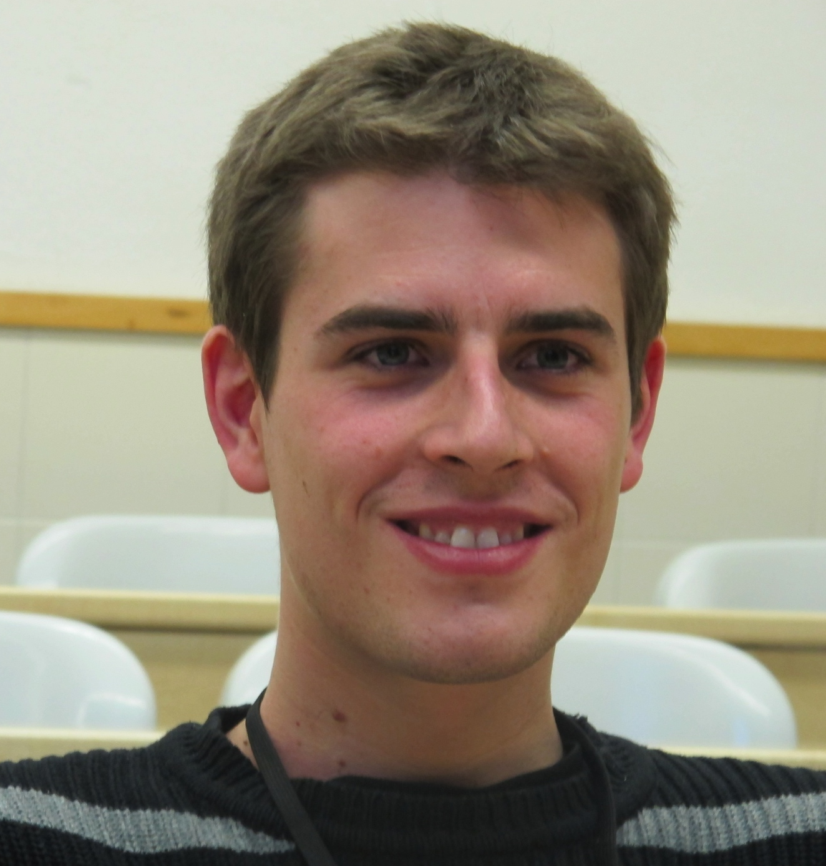



Work in collaboration with
Rubén Capeáns
Gaspar Alfaro
Juan Sabuco
James A. Yorke

Slide 3

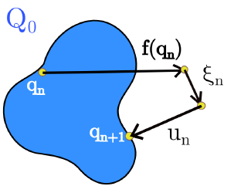




Basic Idea of Partial Control
Q
Admissible trajectories

Slide 4
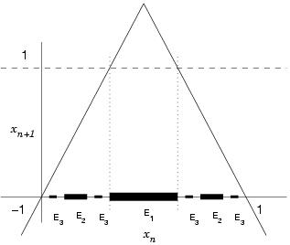





Safe points in the slope-three tent map
Q=[-3/2, 3/2]
3
3/2
-1
+1
-3/2
3/2

Slide 5
Method to compute the Safe Set: Sculpting Algorithm
Every point that belongs to a safe set satisfies the following property:
J. Sabuco, S. Zambrano, M. A. F. Sanjuán and J. A. Yorke.
Finding safety in partially controllable chaotic systems.
Comm. Nonl. Sci. Num. Sim. 17, 4274 (2012).

Slide 6
Partial control in the Duffing oscillator
The goal is to find a safe set in the Duffing oscillator with a choice of parameters where the Wada property arises.
.
q = (x, x’) ; f(q) = time-2π map
Once again we can find a safe set using the algorithm with a control smaller than noise

Slide 7

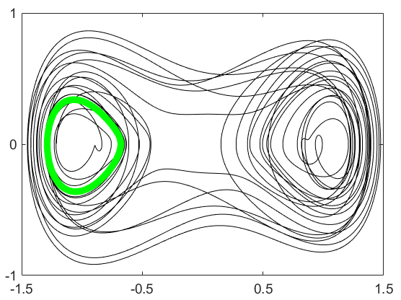
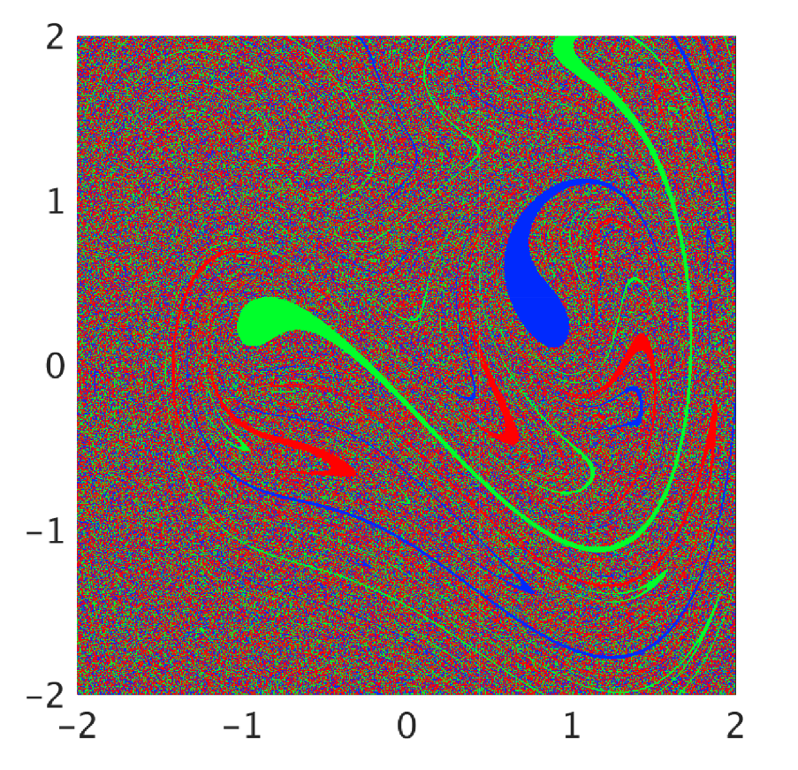
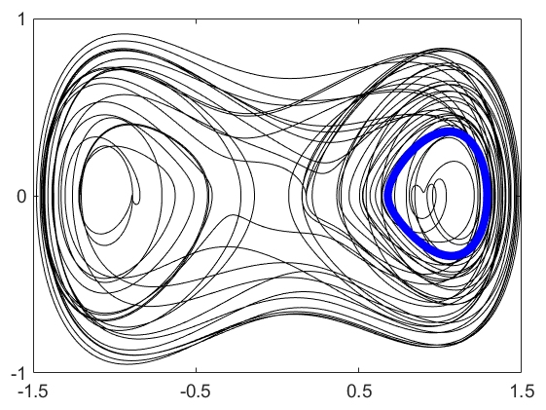

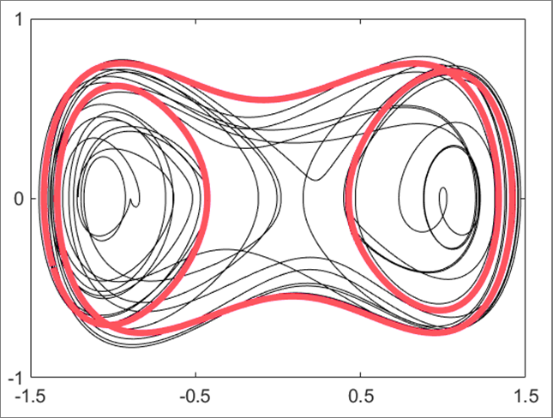

Basin of attraction and phase space orbits of the Duffing oscillator
P1
P1
P1
P1
P3
P3
P3
P3

Slide 8
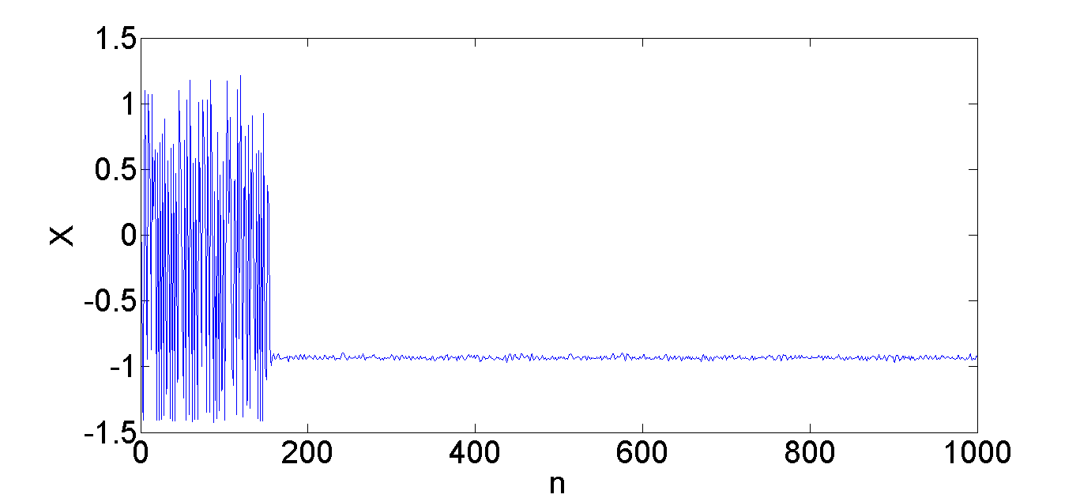
Time series of the Duffing oscillator

Slide 9
The blue set is our Q: the region we want to stay in
Q
Q=Q(0) is the box that contains the square [-2,2]x[-2,2] but with some holes (circles of radius 0.2), centered at the periodic attractors

Slide 10
Step 1
S(0) is the union of the blue and magenta regions.
S(1) is the blue region;
In each successive picture, magenta denotes the part of the sculpture that has been removed.

Slide 11
Step 1

Slide 12
Step 2

Slide 13
Step 2

Slide 14
The initial set has finally converged to a safe set

Slide 15
Safe sets, aymptotic safe sets and admissible safe trajectories
1
1
3
3
3

Slide 16

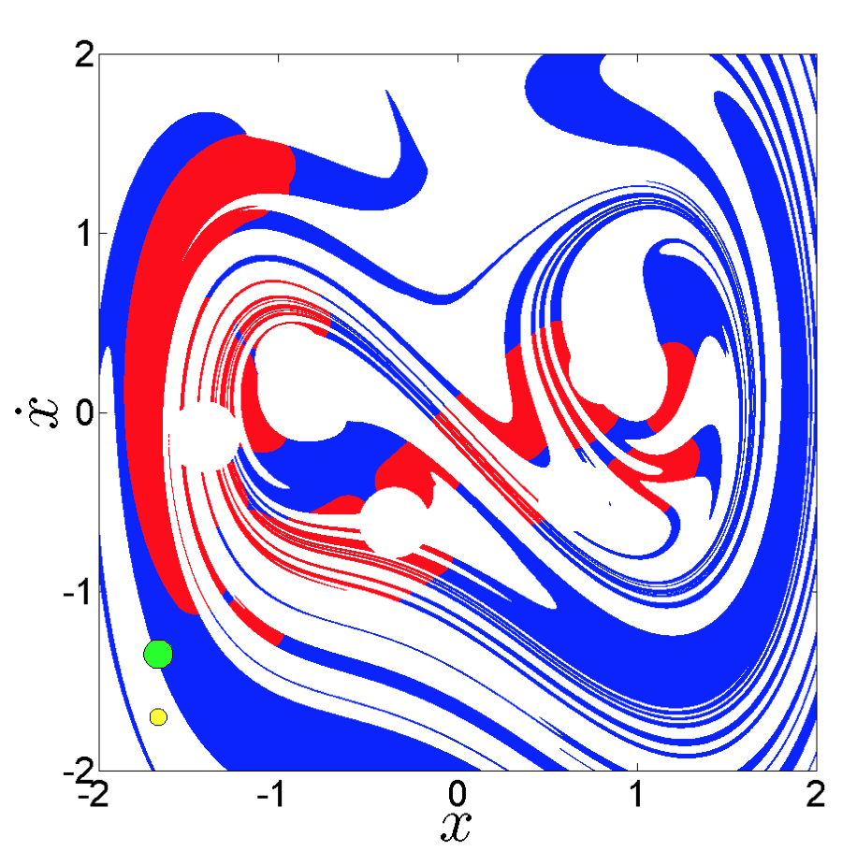
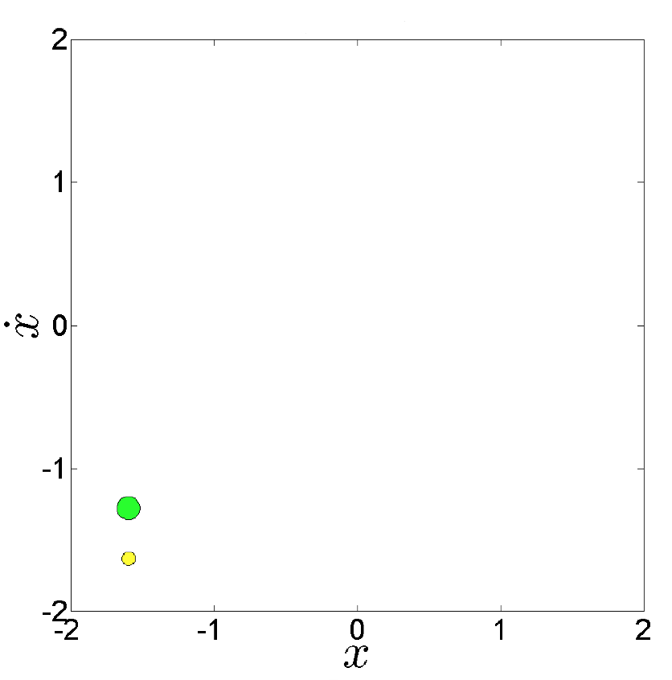
Evolution of the safe sets as u₀ decreases for a given ξ
u_{o}=0.06
u_{o}=0.05
u_{o}=0.0475
u_{o}=0.0471

Slide 17
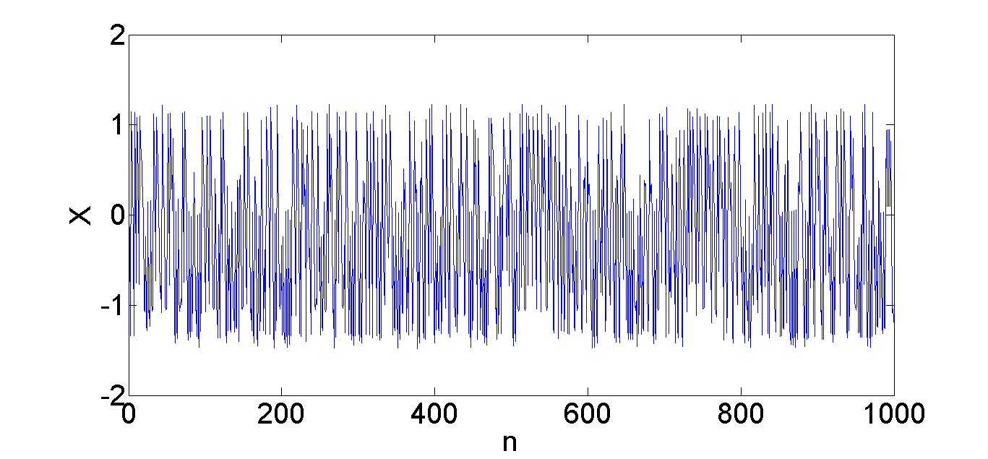
Duffing oscillator controlled

Slide 18


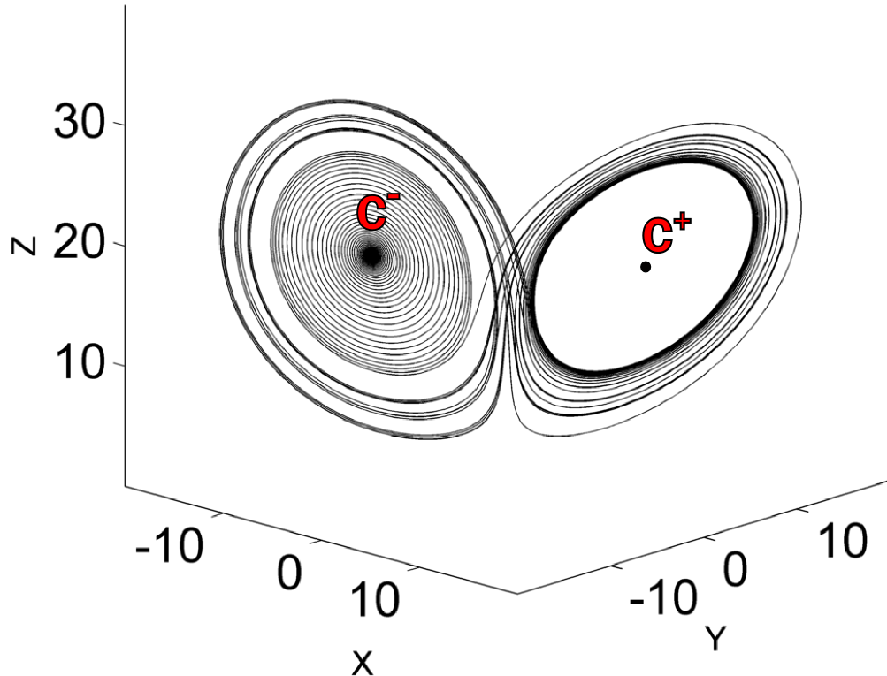
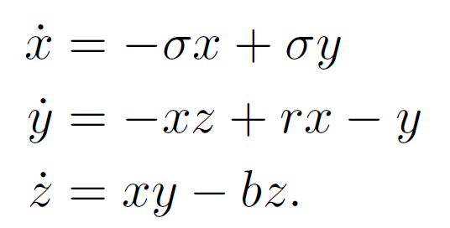
Transient chaos in the Lorenz system
σ=10 b=8/3 r=20
The trajectory eventually escape to one of the attractors C⁺ or C⁻

Slide 19
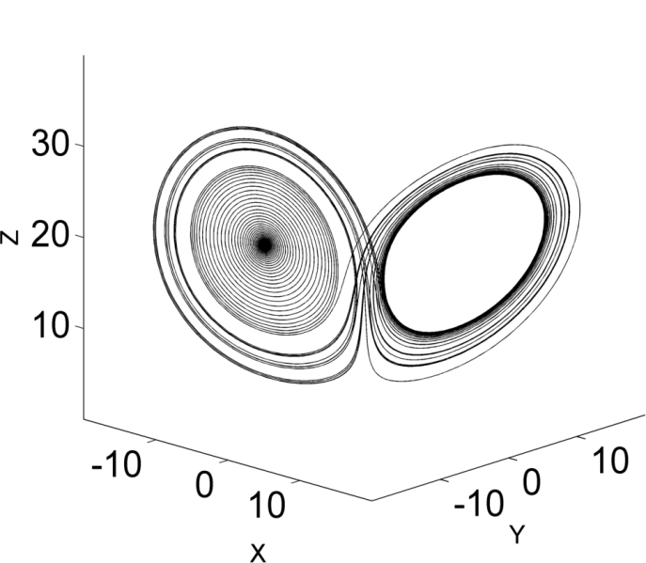


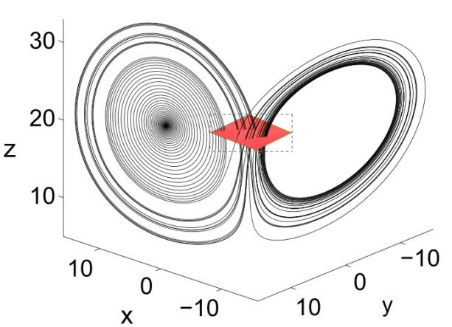
Different ways to discretize the Lorenz system
3D map
1D map
Maxima of z
2D map
Poincaré section

Slide 20





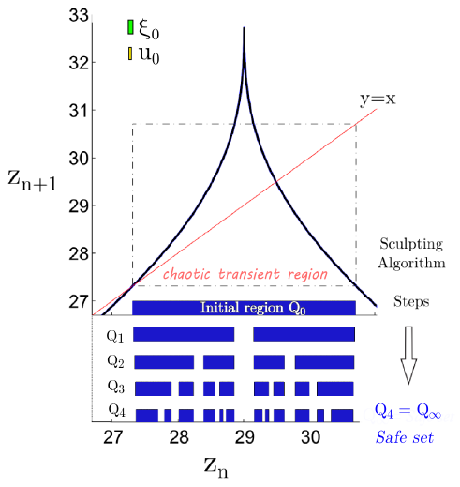
1D map case

Slide 21
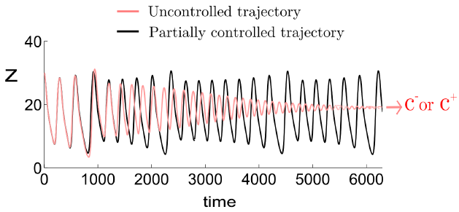
1D map: Controlled trajectory

Slide 22
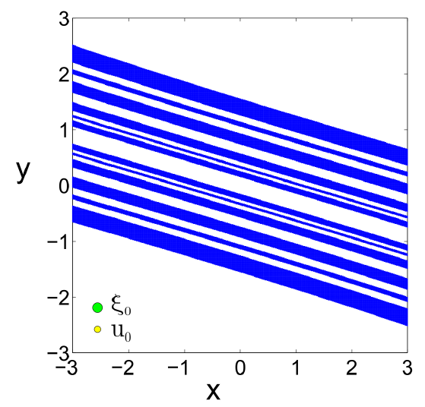
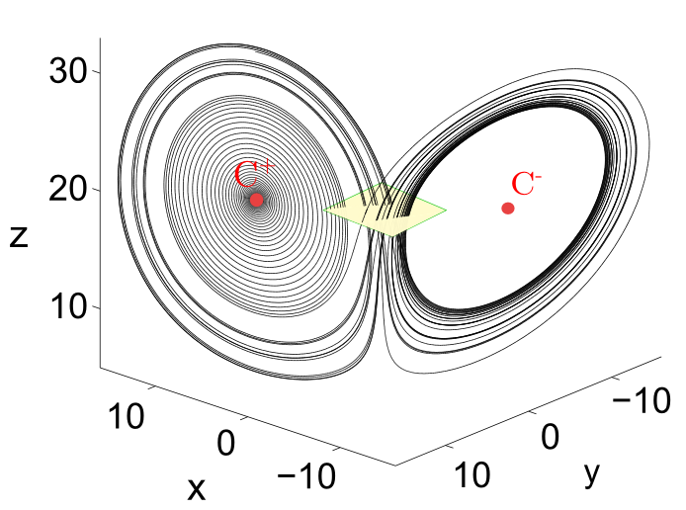
2D map case

Slide 23
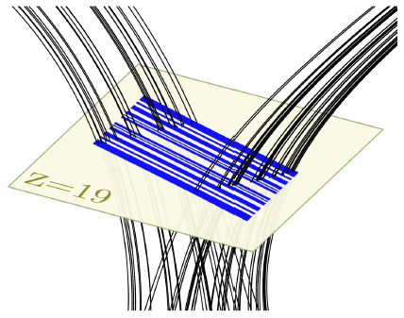
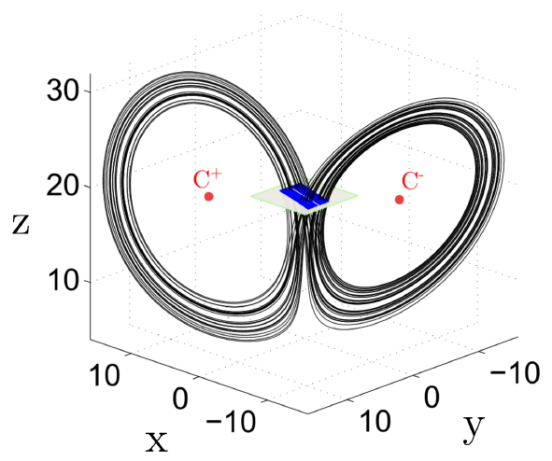
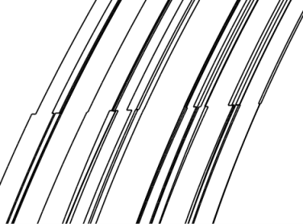
2D map case
Z=19

Slide 24
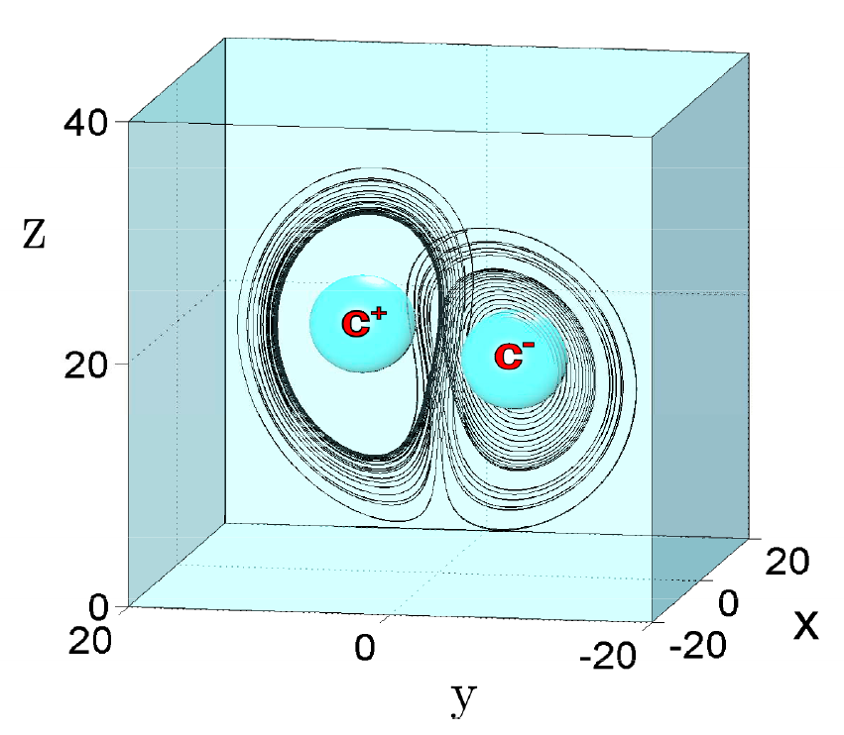
3D Map: Discretization using a time interval Δt

Slide 25
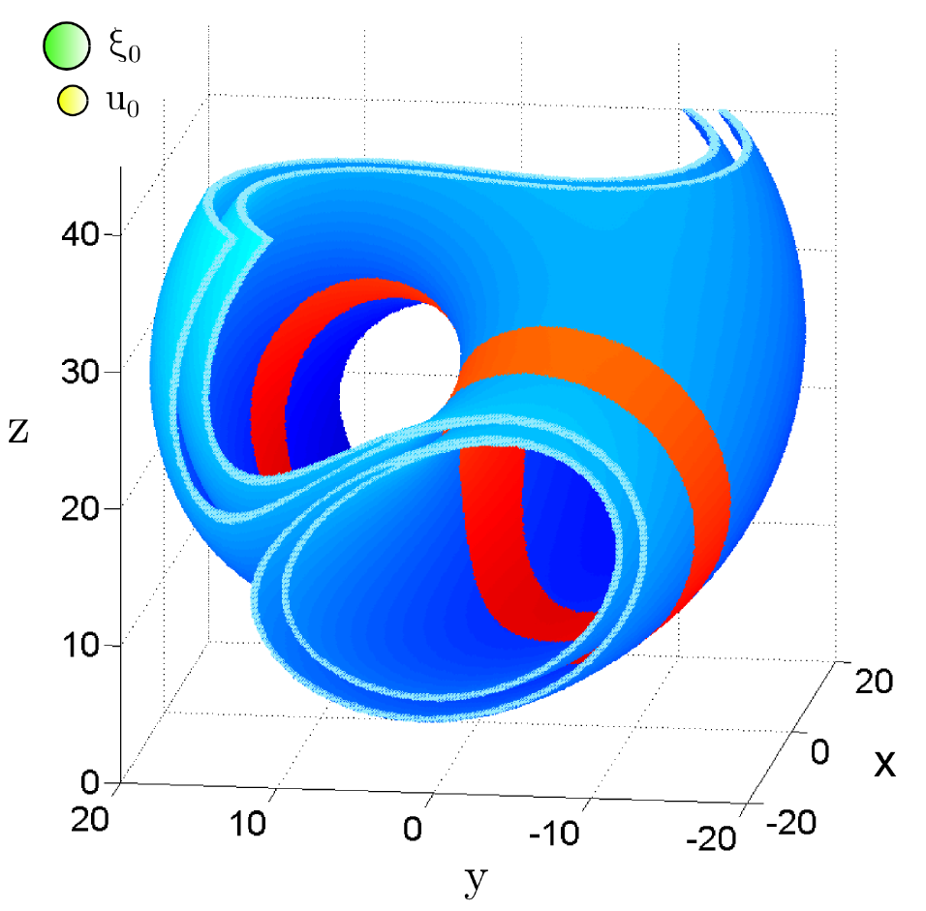

In blue 3D safe set. In red asymptotic safe set

Slide 26
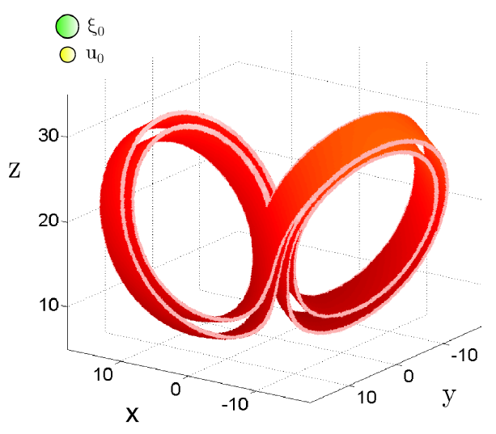
3D map: Asymptotic safe set
The partially controlled dynamics converges to this set

Slide 27
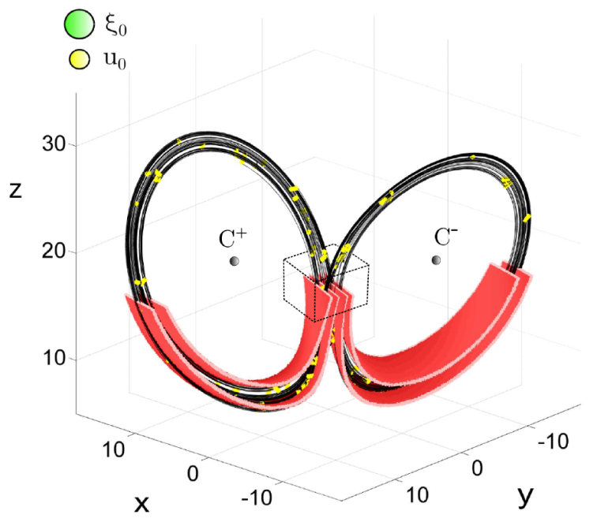
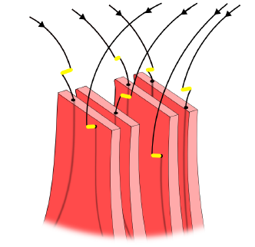
3D map: Controlled trajectories
In yellow the controls are applied every Δt=1.2

Slide 28

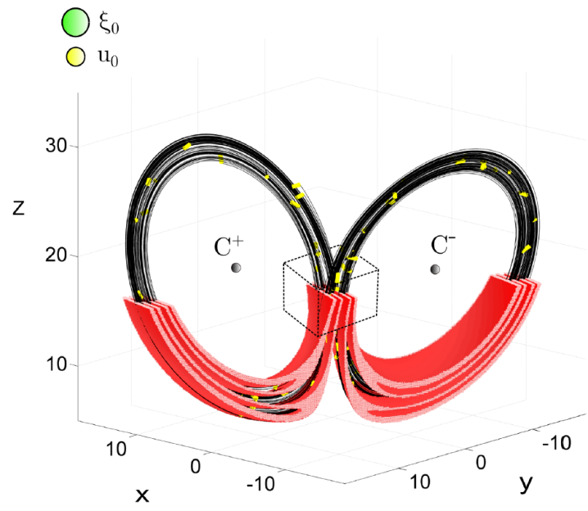
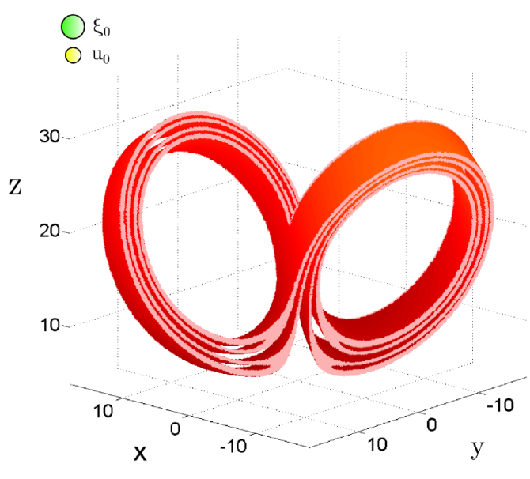
3D map: Flexible control for different Δt

Slide 29
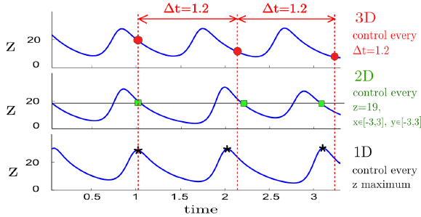
Comparison of the three maps
Comparison of the three controlled trajectories of the z variable
by using a 3D, a 2D and a 1D map. Only the 3D is periodic.

Slide 30
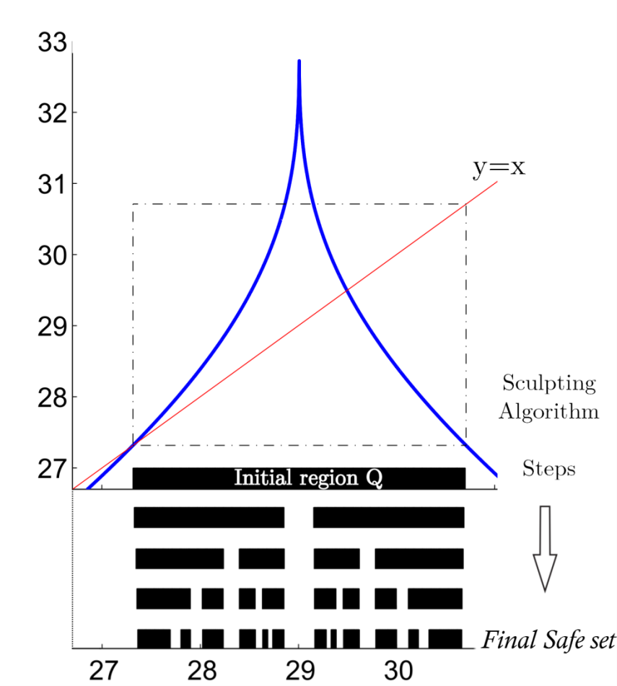
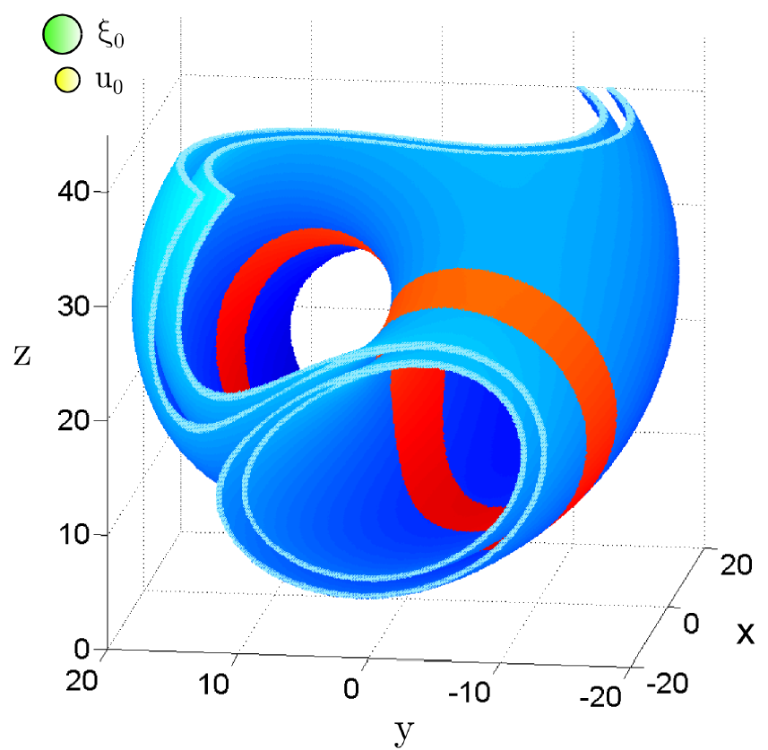
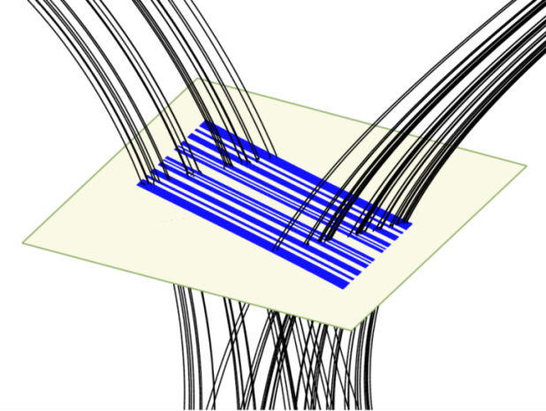
Summary
The Lorenz system as a paradigmatic example in Nonlinear Dynamics

Slide 31
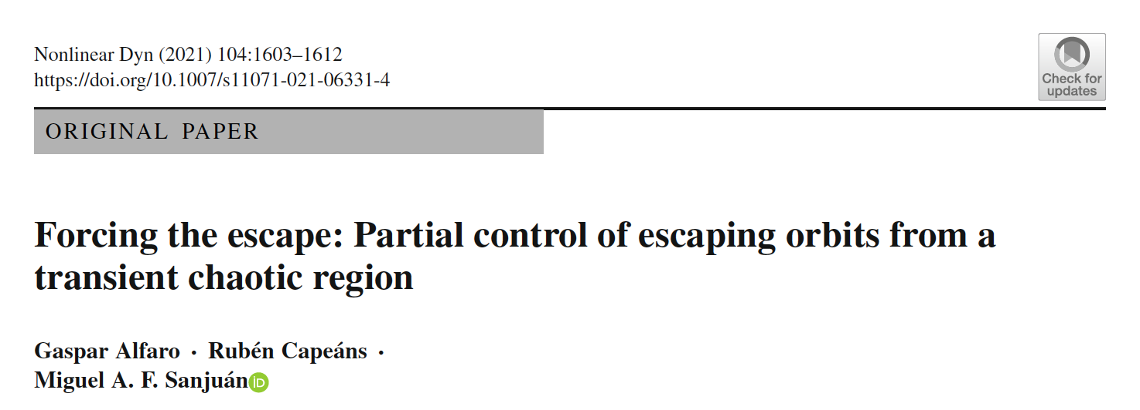
We have developed a new control algorithm based in the partial control method.
The goal of the algorithm is to control in a predictable manner when to escape.
While partial control has been used as a way to avoid escapes, here we want to adapt it to force the escape in a controlled manner.

Slide 32
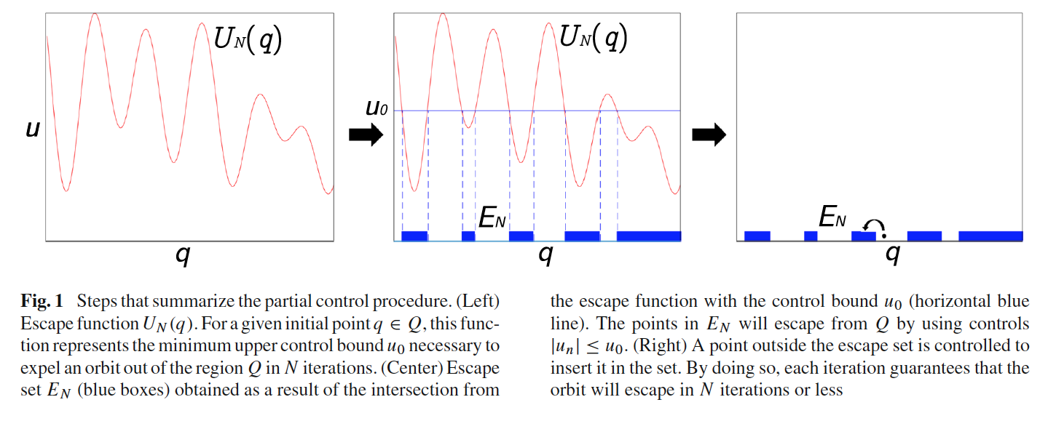
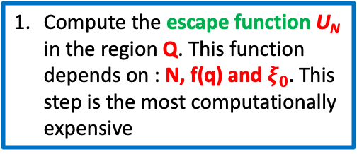

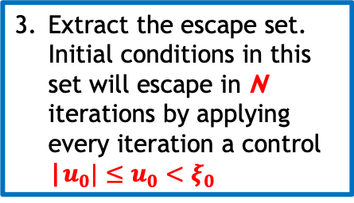
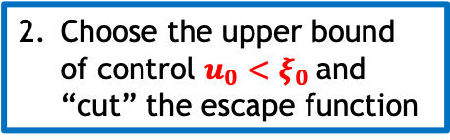
How to control the escape set of an orbit
Compute the escape function U_{N} in the region Q. This function depends on : N, f(q) and $ξ_{0}.$ This step is the most computationally expensive
Choose the upper bound of control $u_{0}<ξ_{0}$and “cut” the escape function
Extract the escape set. Initial conditions in this set will escape in N iterations by applying every iteration a control |$u_{0}|≤u_{0}<ξ_{0}$

Slide 33
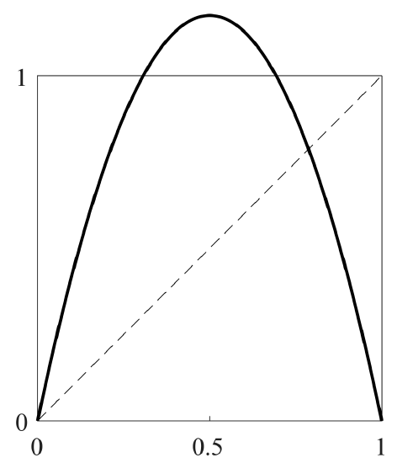
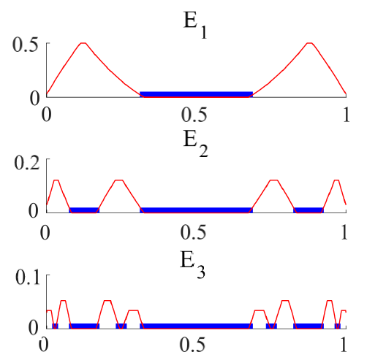
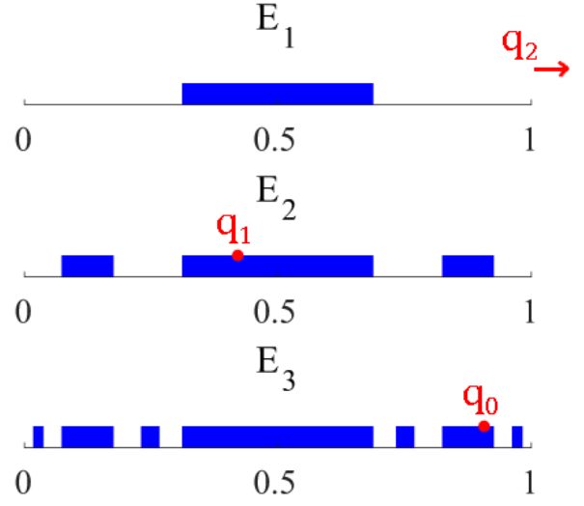
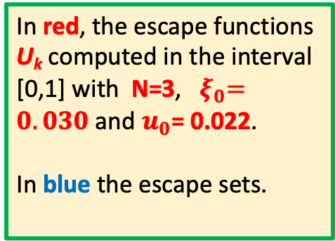
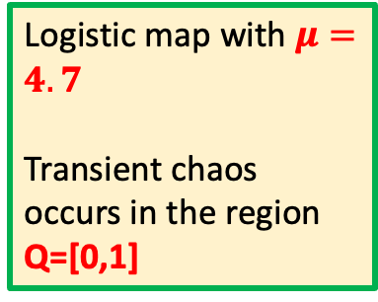
Case A: Escape in N or less iterations
Escape in N=3 or less iterarions
Logistic map with $μ=4.7$
Transient chaos occurs in the region Q=[0,1]
In red, the escape functions U_{k} computed in the interval [0,1] with N=3, ${ ξ}_{0}=0.030$ and $u_{0}$= 0.022.
In blue the escape sets.
Example of a controlled orbit.
All orbits are forced to escape in 3 or less iterations.

Slide 34
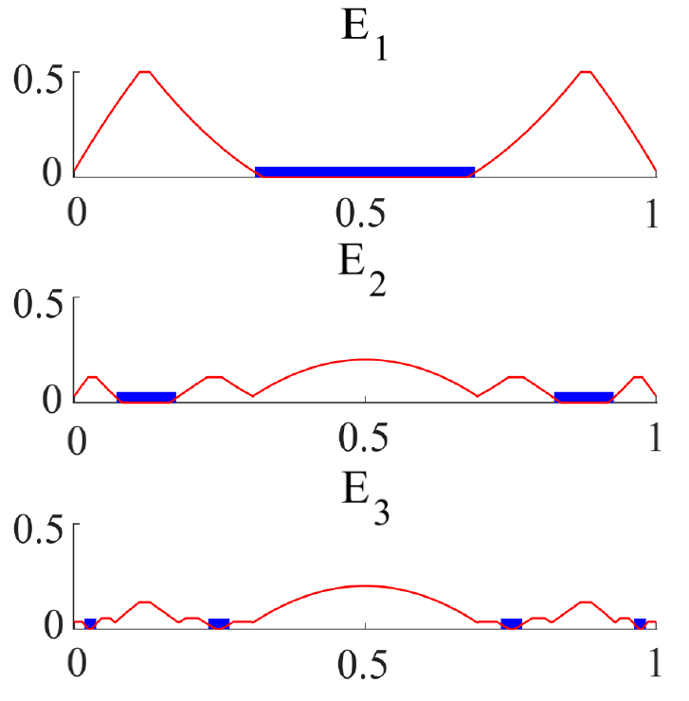
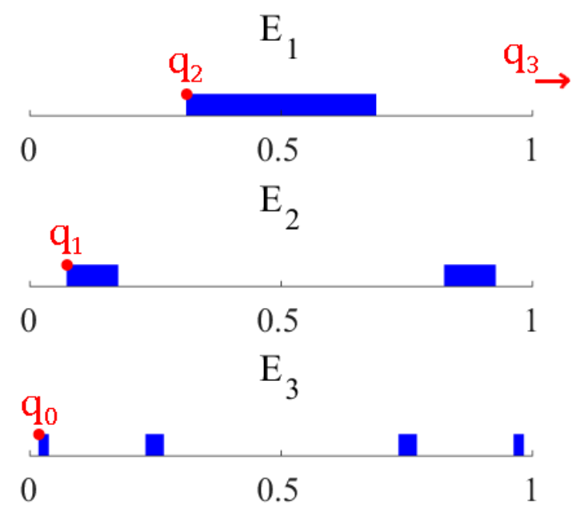
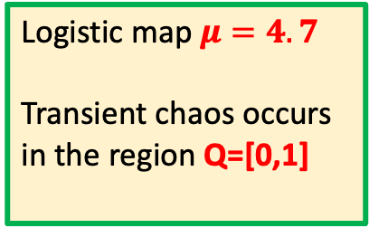

Case B: Escape exactly in N iterations
Escape in exactly N=3 iterarions
Logistic map $μ=4.7$
Transient chaos occurs in the region Q=[0,1]
In red the escape functions U_{k} computed in the Interval [0,1] with N=3, ${ ξ}_{0}=0.030$ and $u_{0}$= 0.022.
In blue the escape sets.
Example of a controlled orbit.
All orbits are forced to escape in exactly 3 iterations.

Slide 35




Case C: Alternating chaotic regions. Controlling the transient between two regions
DOUBLE PARABOLA MAP
For $μ>8$ transient chaos appears.
Orbits “escape” from LEFT to RIGHT and viceversa.
Goal: control the number of iterations that the orbit takes in each side.

Slide 36




Case C: Alternating chaotic regions. Controlling the transient between two regions
Double parabola map with $μ=10$
Left and right escape funtions and the corresponding escape sets, computed for:
N_{l} = 2 and N_{r} = 3 ${ ξ}_{0}=0.015$ $u_{0}=0.014$

Slide 37


Controlled Trajectory
Controlled trajectory
N_{l} = 20 ; N_{r} = 30
${ ξ}_{0} =0.0150$
$u_{0}=$ 0.0135

Slide 38



Beyond partial control: Controlling safety function
Goal: approach any orbit to the safe set.
In the safe set the control needed is minimum

Slide 39



Strategy
We need to compute the safety function and gradually lead the orbit to the minima of this function (the safe set), where the control needed is minimum.
The initial condition x₁ approaches the safe set. The control applied gradually decreases until the minimum value $u_{0}=$ 0.03.

Slide 40




Average number of iterations and average control per iteration to reach the safe set.
$μ=3$
$${ ξ}_{0} =0.05$$
Initial conditions far from the safe set need more iterations and more control to reach the safe set.

Slide 41





Variation of the safe set with ${ ξ}_{0}$ and μ
Here $μ=3$ is kept fixed
H$ere{ ξ}_{0} =0.05$ is kept fixed
In BLUE the $u_{0}$ corresponding to each safe set is plotted.

Slide 42








The 2D safety function for the Hénon map

Slide 43





The 2D safety function for the Lozi map

Slide 44

Safe sets for different values of $ξ$
Hénon Map
Lozi Map

Slide 45
Summary and Conclusions
The partial control method allows to avoid the escape of an orbit from a phase space region in presence of noise with a control smaller than noise. The safe set defines the set where this is posible.
We have developed a new control algorithm based in the partial control method, where the goal of the algorithm is to control in a predictable manner when to escape.
While partial control has been used as a way to avoid escapes, with the new algorithm we are able to force the escape in a controlled manner.
Going beyond the partial control, and with the help of the safety function we can apply the method for any point in the region Q, not necessarily in the safe set.
We have applied the method with the safety function for 2D maps like the Hénon map and the Lozi map
Notes:
This is the way we usually express what the log2 criterion can do: The log 2 criterion allows to detect fractal boundaries in experiments at a given resolution.

Slide 46
Thank you for your attention
miguel.sanjuan@urjc.es
Juan Sabuco, Miguel A. F. Sanjuán and James A. Yorke. Dynamics of Partial Control. Chaos 22, 047507, (2012)
R. Capeáns, J. Sabuco, M. A.F. Sanjuán and J. A. Yorke. Partially controlling transient chaos in the Lorenz equations. Philosophical Transactions of the Royal Society A 375, 2088, (2017)
R. Capeáns, J. Sabuco and M. A.F. Sanjuán. Partial control of chaos: how to avoid undesirable behaviors with small controls in presence of noise. Discrete and Continuous Dynamical Systems - Series B 2, 3237-3274, (2018)
Ruben Capeáns, Juan Sabuco, and Miguel A.F. Sanjuán. A new approach of the partial control method in chaotic systems. Nonlinear Dynamics 98, 873--887 (2019)
Gaspar Alfaro, Rubén Capeáns, and Miguel A. F. Sanjuan. Forcing the escape: Partial control of escaping orbits from a transient chaotic region. Nonlinear Dynamics 104, 1603–1612 (2021)
Rubén Capeáns and Miguel A. F. Sanjuán. Beyond partial control: Controlling chaotic transients with the safety function. Nonlinear Dynamics 107, 2903–2910 (2022)
Rubén Capeáns & Miguel A. F. Sanjuán. Controlling chaotic transients in the Hénon and the Lozi map with the safety function, Journal of Difference Equations and Applications (2022) DOI: 10.1080/10236198.2022.2063050

